Slide 1
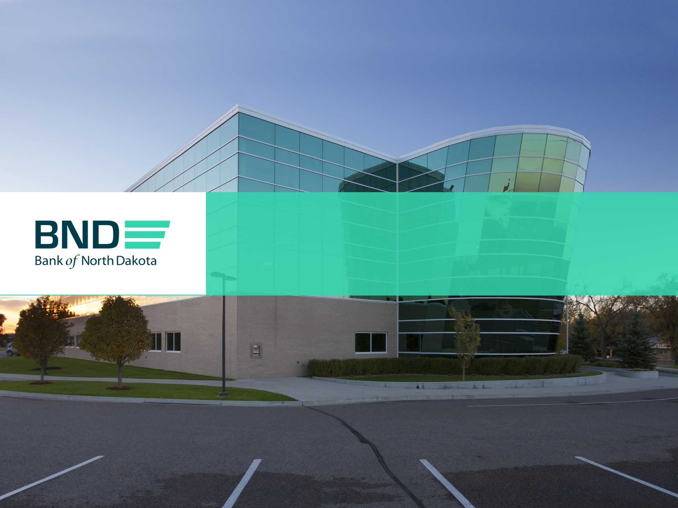
America’s Only Bank--Owned by a State
Serving North Dakota for 103-Years

Slide 2
Mission: To deliver quality, sound financial services that promote agriculture, commerce and industry in North Dakota
BND partners with local financial institutions to “participate” in loans and who serve as the distribution channel for BND programs.

Slide 3
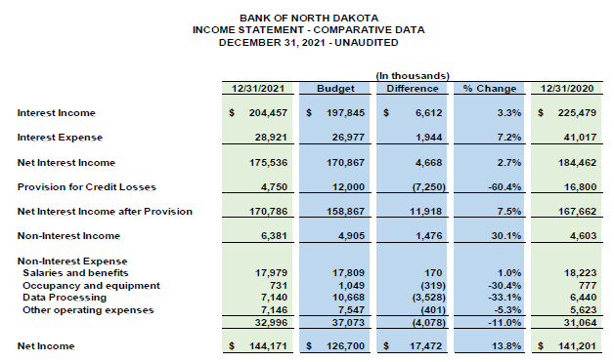
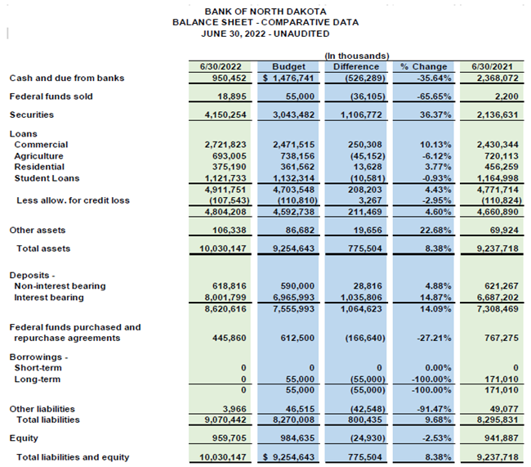
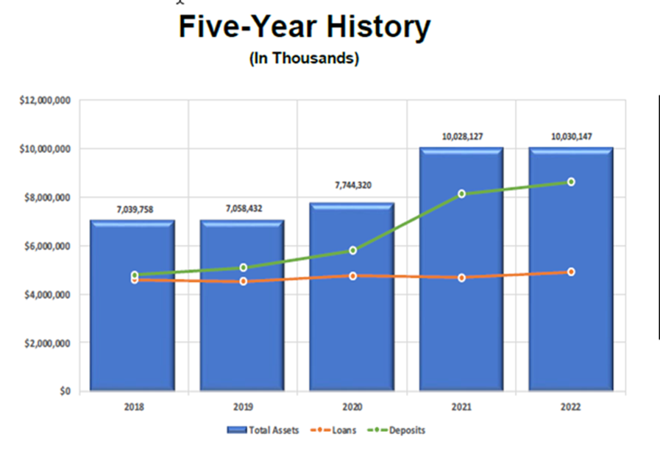

Slide 4
BND—An Economic Engine for North Dakota

Slide 6
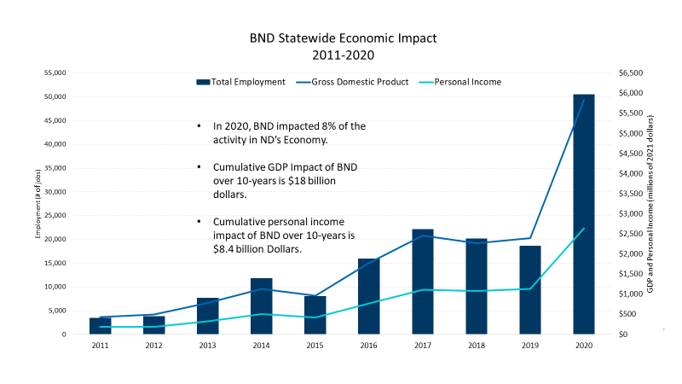

Slide 7
Millions of Dollars

Slide 8
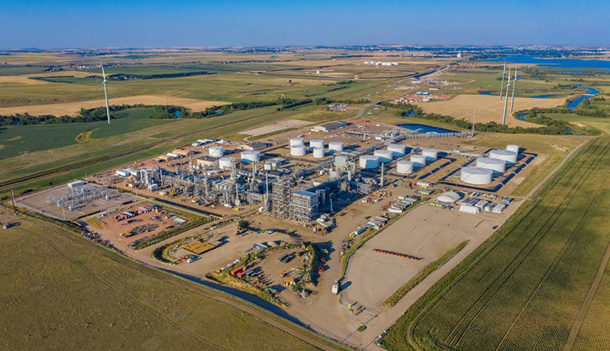
Bank of North Dakota
Loan Programs

Slide 9
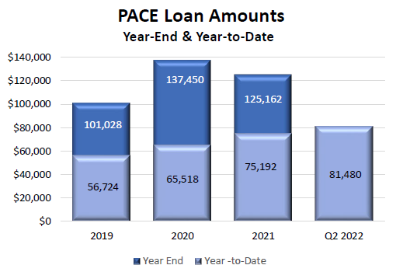
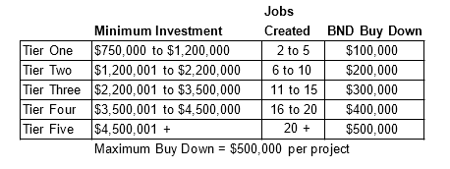
Pace Programs Business and
Provide an Interest Rate “Buydown” for certain Commercial Loans
Based on Investment or Jobs Created
Requires a Community “Match” based on a Percentage Calculation.
Various Versions of “Pace” such as Flex; Affordable Housing; Child Care.
Also have “Ag Pace” Program to provide buydown to “On-Farm” businesses that are integrated into the farm operation. (Support Income Diversification)
PACE Buydown Schedule

Slide 10
Value Added Ag & Energy Guarantee Program
The intent of this program is to encourage lenders to provide financing for projects, which must be located in North Dakota, that add value to North Dakota commodities with a guarantee provided by the Bank.
Value added agriculture is a change made to primary agriculture products (crops and livestock) that increase the product’s value, thereby creating new economic activity and jobs in one of three ways:
Process activities that create value for the product and/or introduce the product to new markets;
Diversification and/or modification of primary agriculture product; or
Pre-production modifications that increase yield, quality and uses
Value added energy is a change made to hydrocarbons or by-products of hydrocarbons produced in North Dakota that increase the product’s value, thereby creating new economic activity and jobs in one of three ways:
Process activities that create value for the hydrocarbon or by-products and/or introduce the product to new markets;
Modifications of hydrocarbons or by-products that result in increased production, quality or uses;
Pre-production modifications that increase production of hydrocarbons through drilling or mining activities.
Program Funding: $80 million

Slide 11
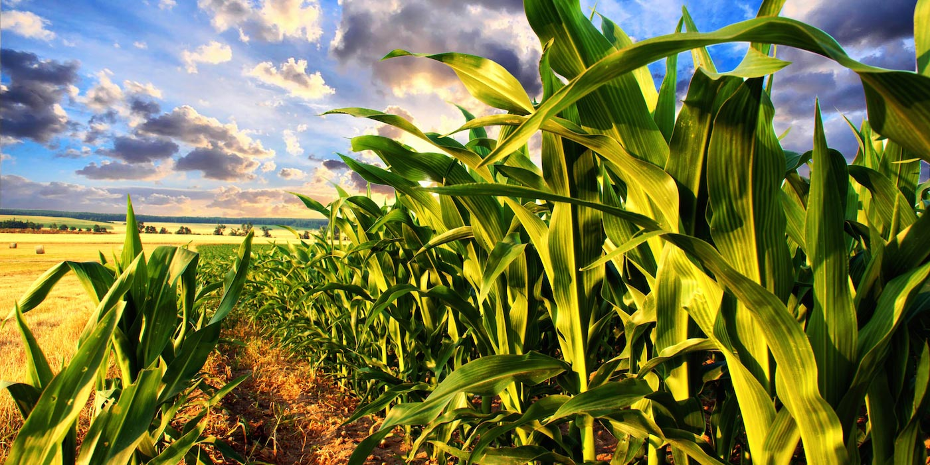
HB1475 Created The Agriculture Diversification and Development Fund (ADD)
Purpose of Fund
To provide Loans, interest rate buydowns, or grants to support new or expanding value - added agriculture businesses that demonstrate financial feasibility, enhance profitability for farmers and ranchers, create jobs, and grow the state's economy.
Value added agriculture businesses include food production or processing facilities; feed or pet food processing facilities; commodity processing facilities; agriculture product manufacturers; and animal agriculture production facilities, including swine, poultry, dairy, and feed lot production facilities.
Administration
The bill provides for the Agriculture Commissioner to appoint an 11-member committee that will screen and approve applications. If approved as a loan, BND will provide administrative services.
Total Funding
$10,000,000
Who Qualifies

Slide 12
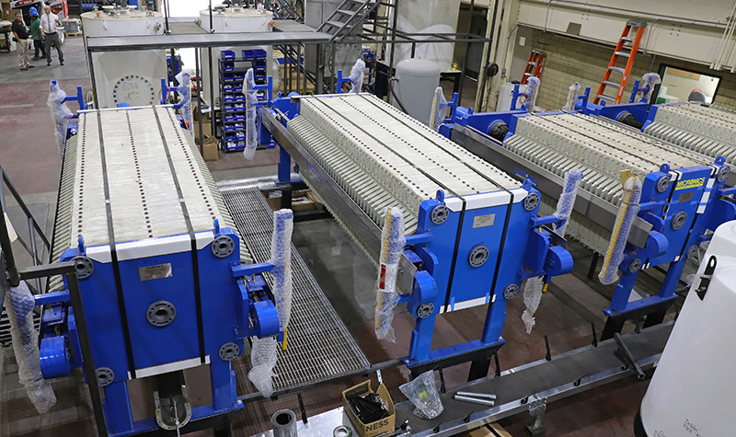
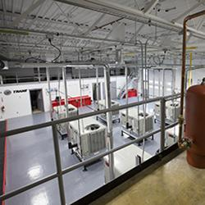
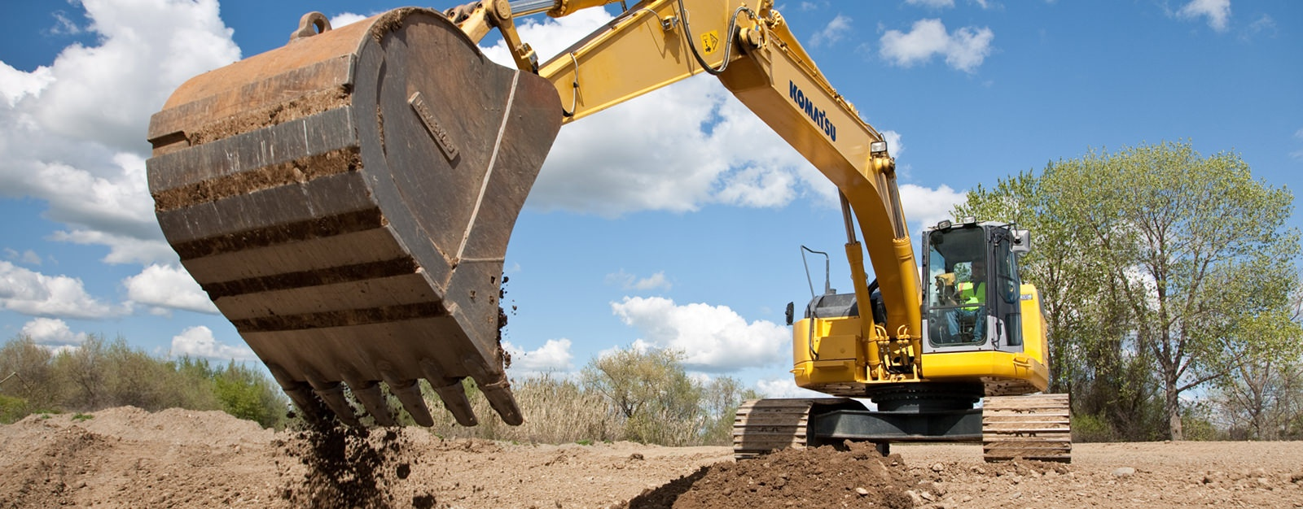
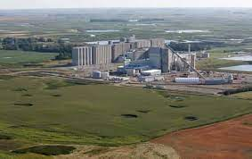
“Match” Loans To Large Scale Projects
MATCH serves as the primary loan program to support large-scale economic diversification projects with investment rated companies.
State Investment Board utilizes the “Legacy Fund” to purchase CD’s at BND to provide funding for the loan.
Goal is to provide bond type interest rates without going to the market.
May be a fixed rate up to 20-years with a like term US Treasury + .25 basis points to BND and up to .25 basis points for the Lead Financial Institution for servicing the loan.

Slide 13
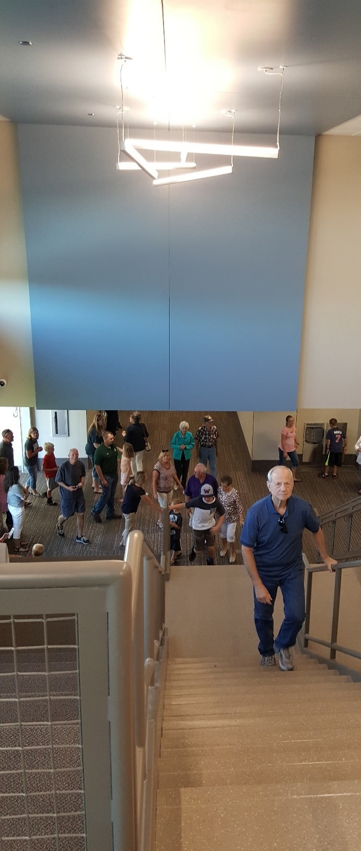
Administered Loan Programs
Infrastructure Revolving Loan Fund
Water Infrastructure Revolving Loan Fund
School construction
Medical PACE buydown
Clean Sustainable Energy Fund
Agriculture Development and Diversification Fund
Legacy Fund Investing in Future Technology (LIFT)
Rebuilders Permanent Loan Fund
Western Area Water Supply
Critical Infrastructure needs loans in Bakken
Emergency lending
To Department of Emergency Services
To Agriculture Commissioner
To Adjutant General

Slide 14
Wrap up and Questions

