Slide 1
Community services
Notes:
Thank you, Shawn.
Good afternoon Chairman Delzer and members of the committee. I am Bonnie Malo, Director of the Division of Community Services (DCS) at the Commerce Department.
I will address the programs within the Division of Community Services. The total appropriation for this biennium is $50,823,035, which includes funding for the Energy Conservation Grants, Weatherization Assistance, Low Income Heating Assistance, CDBG, Emergency Solutions Grant (ESG), North Dakota Homeless Grant (NDHG) and CSBG programs.

Slide 2
We provide the people of North Dakota with effective, efficient and customer-oriented administration of federal and state programs for:
Community Development
Energy Efficiency
Housing
Self Sufficiency

Slide 3
US Housing and Urban Development (HUD)
Community Development Block Grant (CDBG)
Emergency Solutions Grant (ESG)
ND Homeless Grant
US Department of Energy (DOE)
State Energy Program (SEP)
Weatherization
US Department of Health and Human Services
Low Income Home Energy Assistance Program (LIHEAP)
Community Services Block Grant (CSGB)

Slide 4
Housing and urban development
ESG
Provides financial assistance to facilities and programs to identify sheltered and unsheltered homeless persons, as well as those at risk of homelessness, and provide services to help them quickly regain stability in permanent housing after experiencing homelessness. We award grant funds directly to emergency/ homeless shelters and agencies throughout the state for operational and essential homeless prevention, rapid rehousing and the Homeless Management Information System.
CDBG
Provides financial assistance to local governments in the form of grants and loans for public facilities, housing rehabilitation and economic development projects.
Homeless Grant
State program designed to provide financial assistance to facilities and programs within North Dakota to identify sheltered and unsheltered homeless persons, as well as those at risk of homelessness.
Notes:
To augment growth potential, we were able to serve almost 86,000 individuals with the Community Development Block Grant (CDBG) and Community Services Block Grant (CSBG) programs. These programs touch individuals either through services provided by the Regional Planning Councils or the Community Actions Agencies.
The CSBG program helps to directly address poverty in our communities. A client in the Dickinson region turned to the Community Action Agency when she and her three children were threatened with homelessness due to divorce. Her husband lost his job, and she had lost most of her wages due to a recent COVID-19 quarantine. With no sick leave and no financial resources, she worked with staff at the agency to secure permanent housing for her children. This client stated that Community Action’s guidance and financial assistance helped her make decisions during a stressful time.

Slide 5
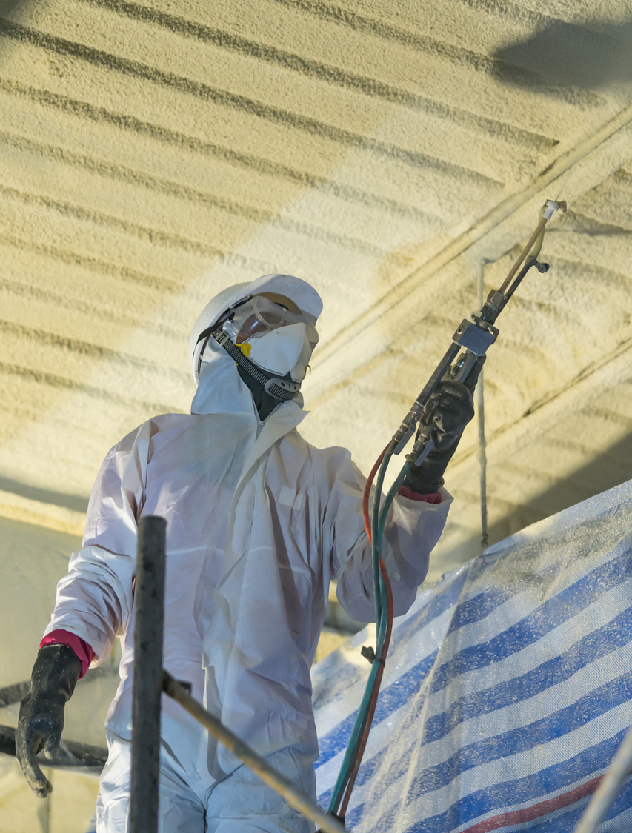
US Dept of Energy
State Energy Program
Promoting Energy Conservation and Efficiency
The State Energy Program provides a range of energy conservation-related opportunities including energy education, installation of energy efficiencies and renewable energy technologies.
Weatherization
Program impact low-income individuals across the state to: • Increase energy efficiency in homes • Strengthen the health and safety of the home • Reduce total residential energy expenditures • Provide conservation measures

Slide 6
U.S. Dept of Health & human services
LIHEAP
Assist families with energy costs. We provide federally funded assistance in managing costs associated with home energy bills, energy crises, weatherization and energy-related minor home repairs.
CSGB
The Community Services Block Grant (CSBG) Program assists communities in implementing anti-poverty programs. The program administers funding from the U.S. Department of Health and Human Services through the state’s seven Community Action Agencies (CAAs), providing various services to low-income persons
Notes:
The Energy Conservation Grant funded 65 projects to political subdivision for this biennium, which will save an estimated $422,535 on energy savings per year.
The State Energy Program funded by the Department of Energy, provided funding to the Bismarck Public Schools System, where they recently installed 46 solar panels at the Bismarck Career Academy. In addition to reduced energy costs, students will now have an educational experience on solar energy production, providing exposure to alternative energy workforce opportunities. The energy cost savings is estimated to be around $3,500 per year.
The Weatherization Program helps to improve housing conditions and save money for our state’s most vulnerable citizens. One manufactured homeowner received weatherization assistance from the Jamestown Community Action Agency that can be directly attributed to remaining in their home because of the assistance they received. Prior to receiving the weatherization assistance, their utility bill was between $400 to $500 per month. After the work was completed, their bill dropped to about $100 per month. This individual was very thankful for the assistance, with tears in her eyes she stated that they would not have been able to stay in their home without the weatherization work.
The CDBG and HOME funds are used to increase the affordable housing options in communities around North Dakota. Affordable housing was cited as the top need in all eight regions of the state during a statewide Needs Assessment Survey conducted in 2020.
The CDBG and HOME funds were an integral part of the capital stack for Monterey & Brighton Place Apartments in West Fargo. These funds were layered with Home Innovations Fund (HIF) funds and Low-Income Housing Tax Credits, allowing to demolish 60 units of Public Housing and then redevelop the site to construct 85 affordable units, significantly increasing the capacity for serving income-qualified families. Without the CDBG and HOME funds, Cass County Housing Authority would not have been able to increase the number of eligible households served in this community.

Slide 7
Emergency Solutions Grant (ESG) and North Dakota Homeless Grant Programs (NDHG)
Notes:
Homelessness and housing insecurity impact thousands of families across the state every day. Jennifer had recently lost her husband to COVID-19 and while grieving, she also became homeless. After staying in her car, Jennifer went to Ministry on the Margins in Bismarck. They were able to provide financial assistance and secure temporary housing, until she was able to find employment and secure permanent housing. These emergency measures prevent individuals from becoming permanently homeless and the stability that temporary housing allows them to develop a plan to move forward to achieve greater self-sufficiency. Without financial support from ESG and NDHG, organizations like Ministry on the Margins would not be able to assist the overwhelming number of people who are in situations like Jennifer’s.

Slide 8
2020 Cares Act Funding
Community Development Block Grant
$6.1 M
Emergency Solution Grants
$5.1 M
Community Service Block Grant
$4.8 M
Notes:
The Division of Community Services has received additional funding through the CARES Act Funds in the amounts of $1.3M in Community Services Block Grant Funds that was distributed to the 7 Community Action Agencies. The Emergency Shelter Grants Programs received $5.1M for homeless assistance. The Community Development Block Grant Program received $6.3M that will be used in conjunction with the Department of Human Services Rent Bridge Program to prevent individuals and family’s from becoming homeless.

