Slide 2
Tourism Division Mission
We build the positive public image of North Dakota as a dynamic place to live and work. By showcasing opportunities and inspiring visitors to Be Legendary, we strengthen the economy and provide opportunity for people across our communities.

Slide 3
2022 tourism state marketing Strategy and Priorities
Increase positive national earned media coverage of North Dakota
Increase awareness of North Dakota and improve image
Increase incremental trips motivated by advertising
Increase visitor spending

Slide 4
Tourism impacts and diversifies ND economy: supporting local businesses and generating state and local taxes
$237.9 million in estimated state and local tax revenue
887,804 airport arrivals
More than 35,000 jobs supported by the industry
4,350,756 hotel room nights sold
More than 2,700 tourism related businesses and organizations
Notes:
As reported in the 2021 annual report. Visitation +19%. Visitor spending +23.5%. State & local tax revenue +8.6%.

Slide 5
VISITation and SPENDING in north dakota
VISITOR SPENDING IN BILLIONS OF DOLLARS
TOTAL VISITORS IN MILLIONS
Notes:
Add 2021 spending is 2.61B up (25.5%)and visitors are 21.71 M (up 19%)

Slide 6
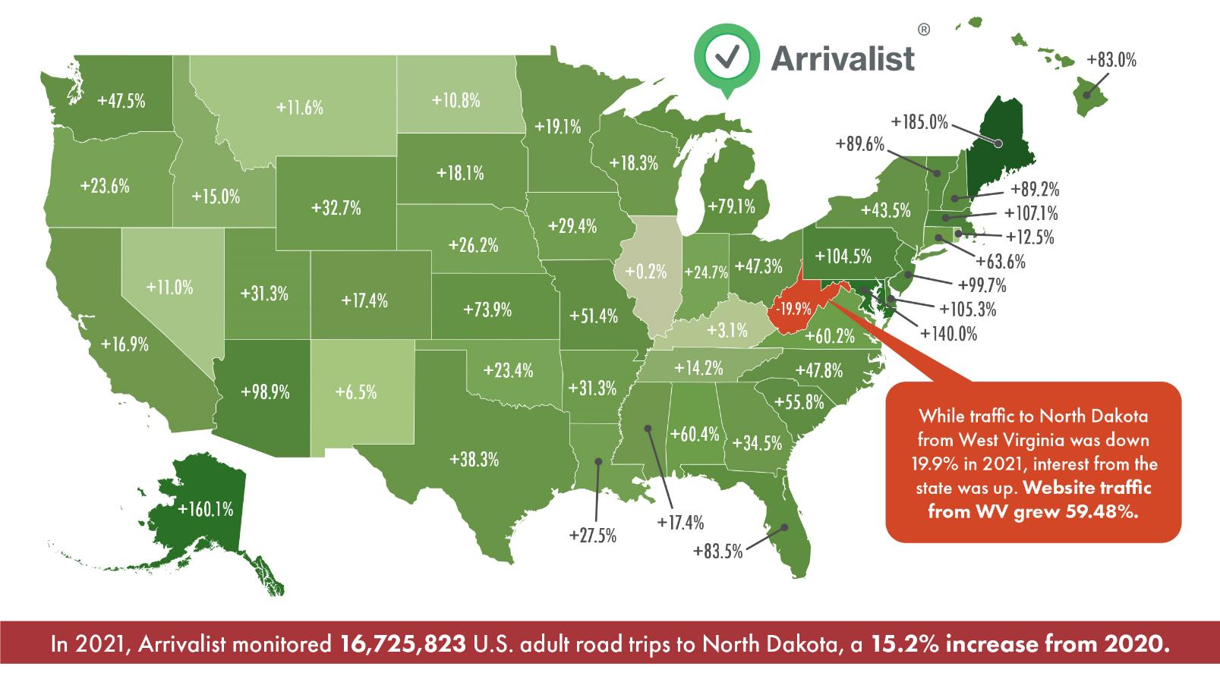
Verified arrivals

Slide 7
Visitor Spending Touches Various Sectors
$384M spending on Lodging
$521M spending on Transportation
$2.6B Total Spending
$374M spending on Recreation
$767M spending on Food & Beverages
$565M spending on Retail

Slide 8
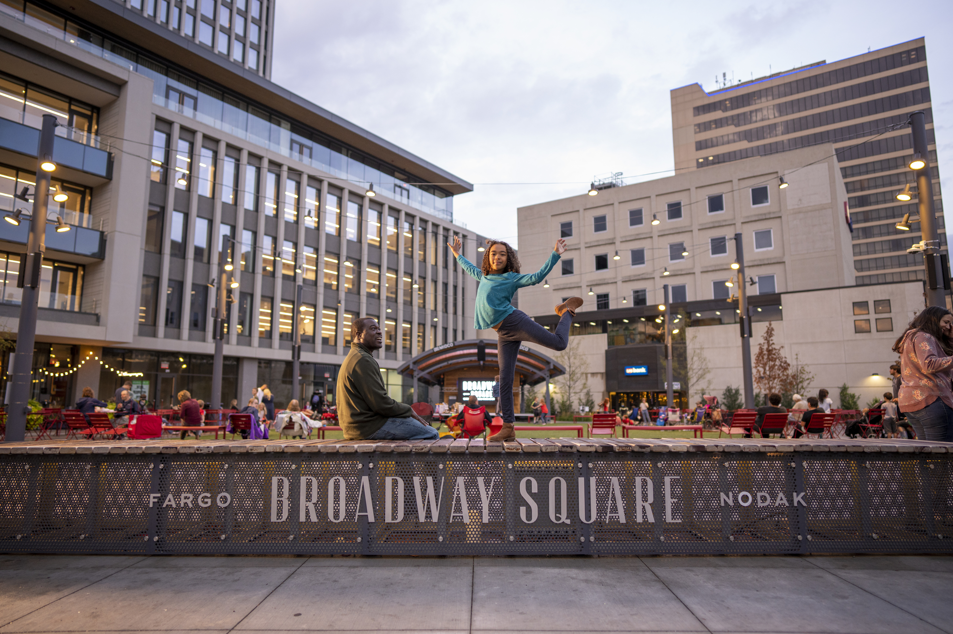
Destination Marketing supports workforce and economic development

Slide 10
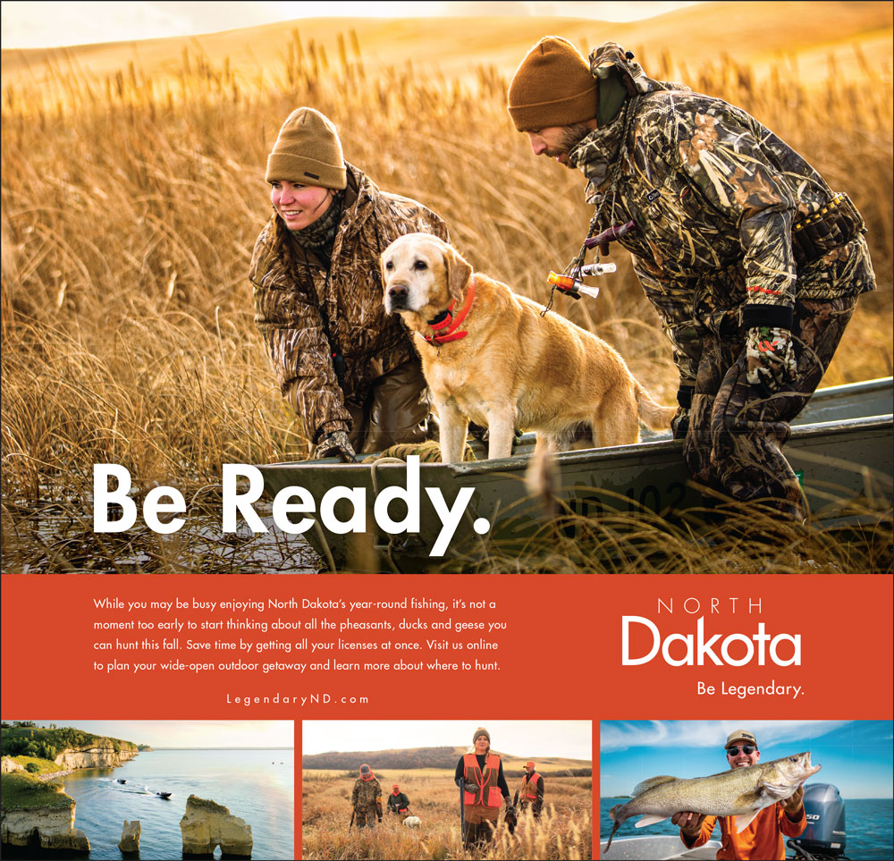
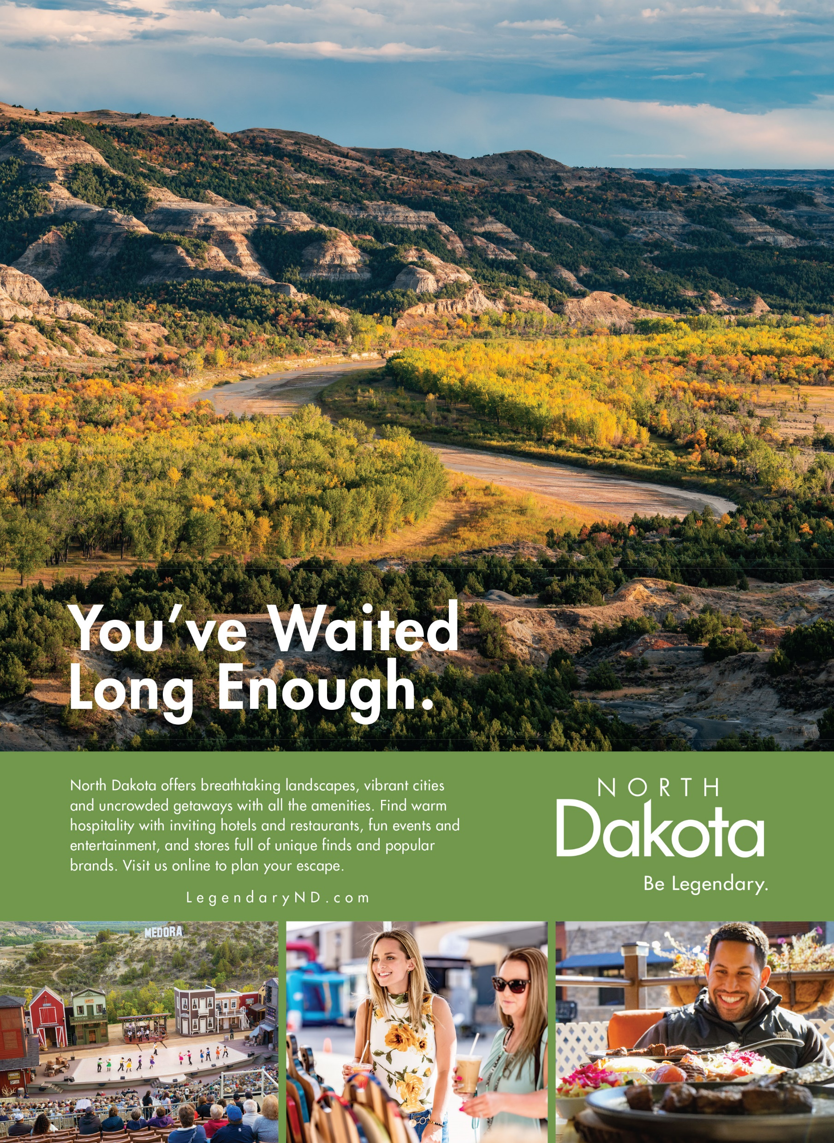
Print
Video
Direct Campaign Results
Web
$7.2
Million
Advertising
Spending
1.4 Million
Influenced Trips
$241.9
Million
Influenced Visitor Spending
Notes:
Longwoods International reported 1.4 million trips that wouldn’t have taken place if not for the advertising. In terms of ROI, for every $1 invested in advertising there were $34 generated in visitor spending and $3 in tax revenue for the state.

Slide 11
Destination Advertising – improves more than visitation

Slide 12
Advertising impact on north Dakota’s image

Slide 13
Competitive set image ratings
Percent Who Strongly Agree

Slide 14
Q2 and YTD Performance metrics
Q2 2022
Website sessions | Traditional Inquiries | Hotel Occupancy | National Park Visits | Airport Arrivals | Canadian Border Crossings | Tax Revenue (thru Q1) | Arrivals Tracked
654,628 | 9,423 | 47.70% | 208,761 | 256,647 | 71,958 | $460,490,248 | N/A
+2% | -28% | +4.8% | -16% | +14% | +340% | +% | N/A
YTD 2022
+2% | -2% | +14.4% | -20% | +29% | +270% | +0.15% | N/A
Notes:
updated

Slide 15
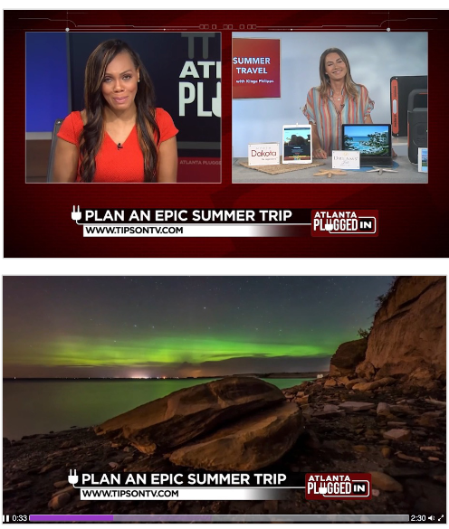
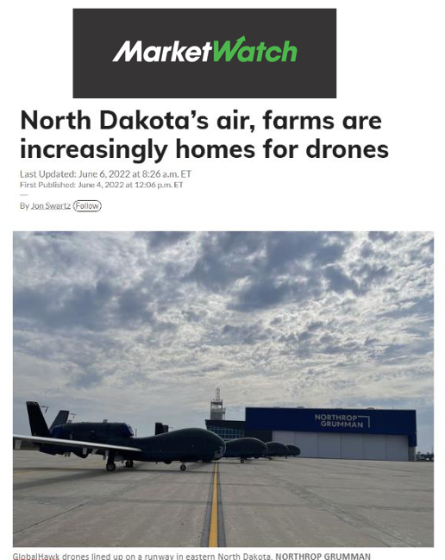
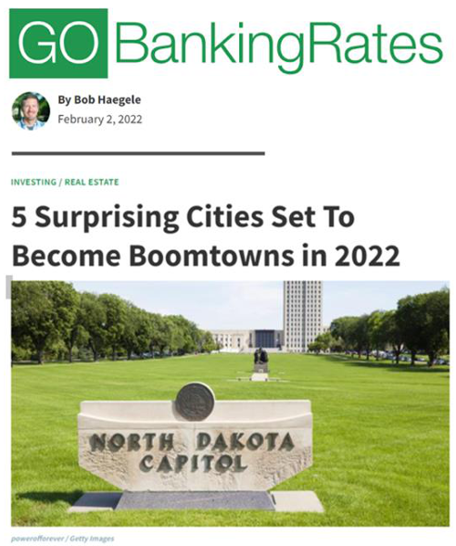
National- regional earned media YTD
North Dakota’s stories have garnered 1,833 placements reaching 7.8 Billion in 2022!

Slide 16
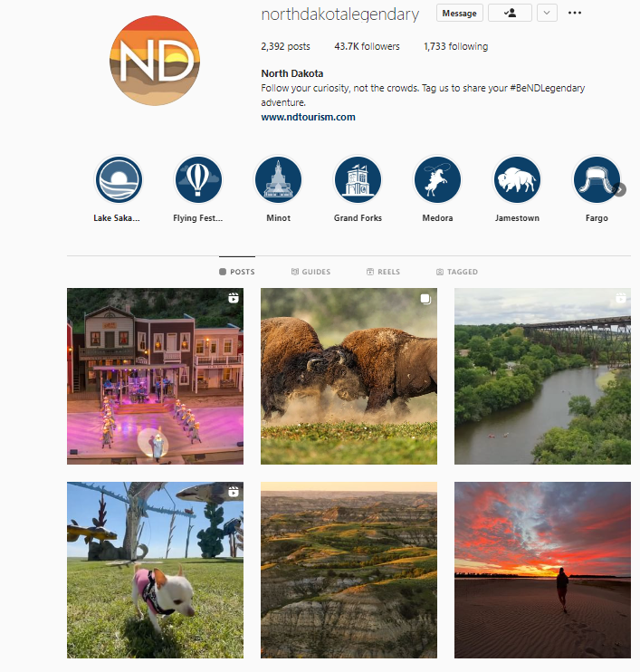
Quarterly Social Media
New TikTok account launched. Results first weeks: 50,000 views and over 3,000 followers. This is over 600% faster growth than Facebook and Instagram.
Impressions: 6.14 million
Video Views: 704.6 thousand
Engagements: 171.7 thousand
Followers: 164,350
Commerce
Impressions: 239K
Engagements: 9.2K
“New”
Find the Good Life ND
Impressions: 37.5K
Engagements: 3K

Slide 17
quarterly KPI- performance metrics
TRADITIONAL INQUIRIES
9,423
ENEWS VISITS TO SITE
Leisure – 1,767
H&F – 142
LIVECHATS
153 by Counselor
94 by BOT
WEBSITE VISITS
654 K
DIGITAL AD CONVERSION
27.85K
MEDIA PLACEMENT
Tourism – 598 national media mentions reaching 3.65 billion.
Quality of place – 48 national media mentions reaching nearly 515.4 million.
Primary topic — Best places to live.
Business – 58 national media mentions reaching nearly 384.5 million.
Primary topics —Bitzero/Crypto and Mitsubishi Hydrogen.
Workforce – 23 national media mentions reaching 81 million.
Primary topic — Expanded workforce training.
INTENT TO TRAVEL METRICS

Slide 18
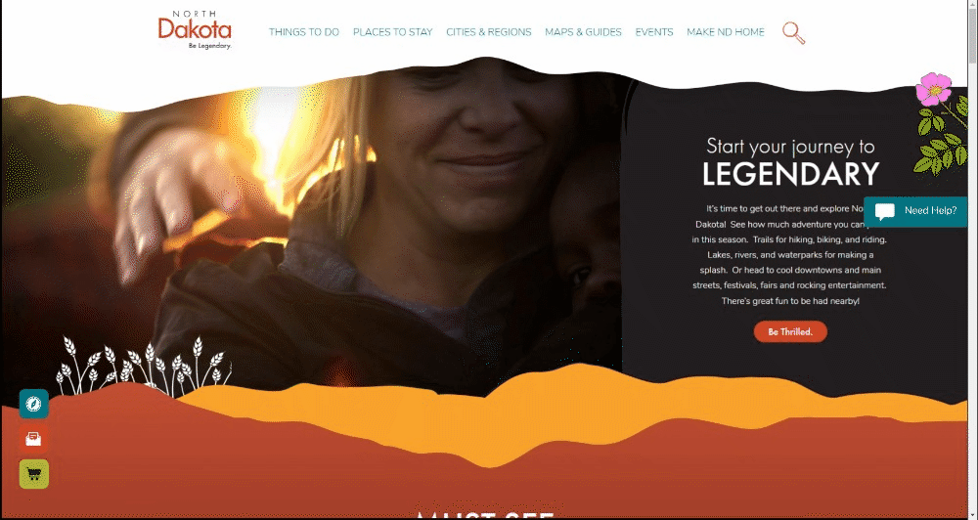
Ndtourism.com
New NDtourism.com.
Potential to be the one-stop shop for all North Dakota activities
Live chat feature
Launched May 2021 - YTD – 2,278 Chats handled. Q2 - 2022 - 153 Chats
Launched Live Help BOT – June 2022 and since launch, the BOT has serviced 239 Chats and only 6 have resulted in a Chat with a travel counselor. Q2 –2022 has resulted in 94 BOT responses.
Updated Partner Portal
Since launch of updated portal (December 28th, 2021) - over 78,991 field updates have been completed on listings by over 150 users.
YTD Website Traffic – continues to show increase from 2021 as well as record breaking traffic from 2020.
Visits – Q2: 654,628 +1.66% from 2021
YTD - 1,497,795 +14.36% from 2021 and record increase from 2020 of +36%.
Pageviews - Q2: 760,873 +.89% from 2021
YTD - 1,748,572 +10.54% from 2021 and record increase from 2020 of +20%.
Notes:
Can we have the website running in this frame, so we show the videos and energy? Or no
New site showcases the vibrancy and energy of the state with new look, improved usability, and priority on SEO (google core vitals)

Slide 19
Hiring new Manager of Tourism Development
Opportunities abound in North Dakota
Outdoor Recreation
Agri Tourism
Complete Packages – ND Native Tourism Alliance
Amenities

Slide 20
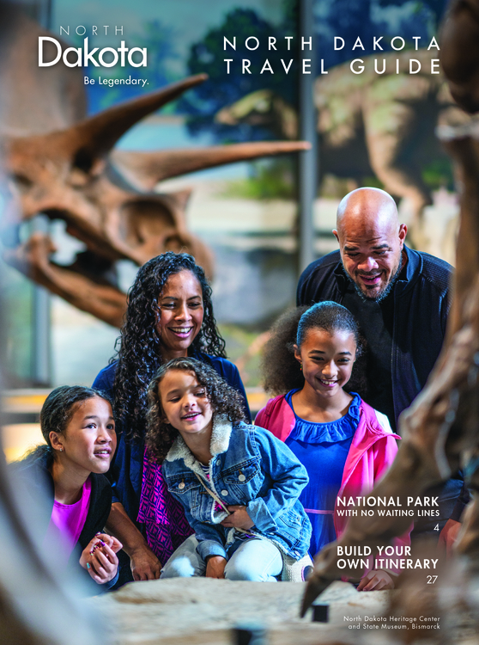
Sales
Tourism Operations
Visitor support
Global sales efforts
Five state marketing cooperative - Great American West brand in 13+ countries
Group sales
Building capacity and demand
Outdoor recreation development
Agency partnerships, media relations, capacity building

Slide 21
The value we provide
New resources for partners
Improved awareness – to improve your results
14,000+ new photos available from 21+ communities
71% increase in usage
campaign shoot, cooperative programs, partnerships – Brand USA and Parks
2022 Travel guide – streamlined listing, improved accuracy
E-Book available for guide - https://www.ndtourism.com/maps-guides
Cooperative programs – makes marketing easier and more affordable
paid advertising, social, influencers, photography
Grants – COVID grants, Main Street Tourism grants

Slide 22
can we help you?
Marketing consultations
Cooperative programs simplify and align efforts statewide: sales events, influencers, social take overs, paid advertising, photography
Shared creative assets: photos, videos
Website enhanced FREE listings
Literature distribution
Access to research
Fall marketing summit and annual TIC

Slide 23
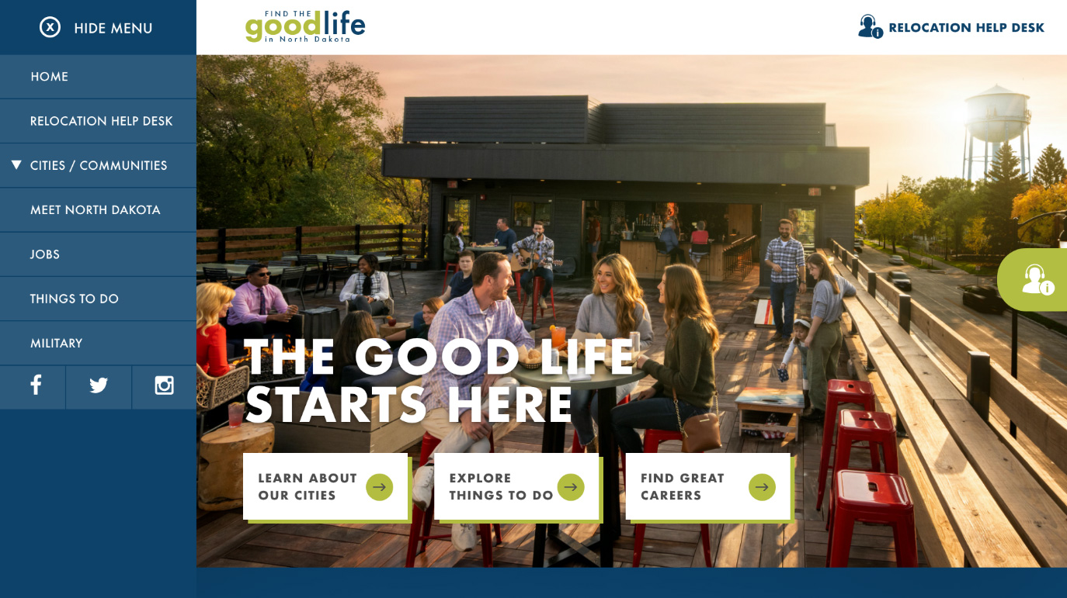
Find the Good Life in north Dakota 2.0

