Slide 1
2020-2024 State of North Dakota
Consolidated Plan
Sponsored by
North Dakota Department of Commerce
Welcome to the
Public Review Meeting!
April 21, 2020

Slide 2
Why Prepare a
Consolidated Plan?
In exchange for receiving HUD funds, recipients must prepare four things:
1. A Five-Year Consolidated Plan
2. Annual Action Plan
3. Performance and Evaluation Report
4. Analysis of Impediments

Slide 3
Purpose of the
Five-Year Consolidated Plan
Help us identify housing and community development needs, priorities and strategies
Help us indicate how state and federal funds will be allocated to address these needs and activities over five years
Annual action plan sets actions for 1st yr.

Slide 4
Resources (2020)
CDBG: $3,991,758
HOME: $3,000,000
ESG: $485,414
NHTF: $3,000,000
** Do not include the additional resources allocated in the CARES Act

Slide 5
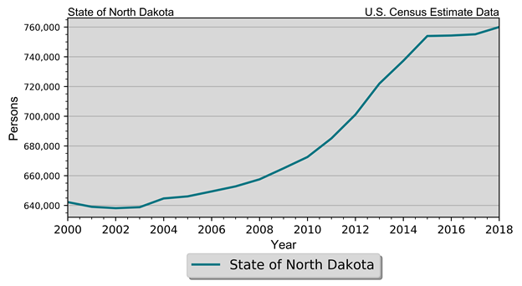
Demographics
Population Estimates State of North Dakota 2010-2018 Census Data and Intercensal Estimates
2010 Census | 672,591
2011 Population Estimate | 685,136
2012 Population Estimate | 701,116
2013 Population Estimate | 721,999
2014 Population Estimate | 737,382
2015 Population Estimate | 754,022
2016 Population Estimate | 754,353
2017 Population Estimate | 755,176
2018 Population Estimate | 760,077

Slide 6
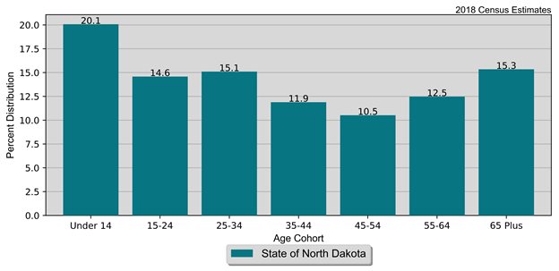
Demographics
Population by Age and Gender
State of North Dakota
2010 Census and Current Census Estimates
Age | 2010 Census | 2018 Estimates | % Change
 |  |  | 18-Oct
Under 14 years | 124,461 | 152,549 | 22.60%
15 to 24 years | 106,430 | 110,861 | 4.20%
25 to 44 years | 90,485 | 114,800 | 26.90%
45 to 54 years | 75,262 | 90,402 | 20.10%
55 to 64 years | 96,657 | 80,005 | -17.20%
65 and Over | 81,819 | 94,823 | 15.90%
Total | 672,591 | 760,077 | 13.00%

Slide 7
Demographics
Population by Race and Ethnicity State of North Dakota 2010 Census & 2018 Five-Year ACS
Race | 2010 Census |  | 2018 Five-Year ACS
 | Population | % of Total | Population | % of Total
White | 605,449 | 90.0% | 655,268 | 87.1%
Black | 7,960 | 1.2% | 20,445 | 2.7%
American Indian | 36,591 | 5.4% | 39,462 | 5.2%
Asian | 6,909 | 1.0% | 10,814 | 1.4%
Native Hawaiian/ Pacific Islander | 320 | 0% | 378 | 0.1%
Other | 3,509 | 0.5% | 7,528 | 1.0%
Two or More Races | 11,853 | 1.8% | 18,306 | 2.4%
Total | 672,591 | 100.0% | 752,201 | 100.0%
Non-Hispanic | 659,124 | 98.0% | 725,672 | 96.5%
Hispanic | 13,467 | 2.0% | 26,529 | 3.5%

Slide 8
Demographics
Disability by Age State of North Dakota 2018 Five-Year ACS Data
Age | Male |  | Female |  | Total
 | Disabled Population | Disability Rate | Disabled Population | Disability Rate | Disabled Population | Disability Rate
Under 5 | 187 | 0.7% | 127 | 0.5% | 314 | 0.6%
5 to 17 | 3,847 | 6.2% | 1,689 | 2.9% | 5,536 | 4.6%
18 to 34 | 4,989 | 4.8% | 5,376 | 5.9% | 10,365 | 5.3%
35 to 64 | 15,931 | 11.8% | 12,484 | 9.7% | 28,415 | 10.8%
65 to 74 | 7,279 | 25.3% | 6,059 | 20.7% | 13,338 | 23.0%
75 or Older | 9,142 | 47.7% | 12,234 | 45.9% | 21,376 | 46.7%
Total | 41,375 | 11.0% | 37,969 | 10.5% | 79,344 | 10.8%

Slide 9
Homelessness
Homeless Count
State of North Dakota
2019 PIT Count
Year | 2015 | 2016 | 2017 | 2018 | 2019
Sheltered | 819 | 707 | 758 | 494 | 545
Unsheltered | 486 | 216 | 331 | 48 | 12
Total | 1,305 | 923 | 1,089 | 542 | 557

Slide 10
Homelessness
Homeless K-12 Students State of North Dakota North Dakota Department of Public Instruction
 | 2014 | 2015 | 2016 | 2017 | 2018 | 2019
Total Homeless Count | 2,436 | 2,828 | 2,777 | 2,362 | 2,204 | 2,554

Slide 11
Economics
Households by Income State of North Dakota 2010 & 2018 Five-Year ACS Data
Income | 2010 Five-Year ACS |  | 2018 Five-Year ACS
 | Households | % of Total | Households | % of Total
Less than $15,000 | 39,425 | 14.3% | 31,291 | 9.9%
$15,000 to $19,999 | 16,011 | 5.8% | 13,158 | 4.2%
$20,000 to $24,999 | 16,678 | 6.0% | 12,633 | 4.0%
$25,000 to $34,999 | 32,772 | 11.8% | 27,910 | 8.9%
$35,000 to $49,999 | 41,563 | 15.0% | 39,929 | 12.7%
$50,000 to $74,999 | 55,089 | 19.9% | 57,047 | 18.1%
$75,000 to $99,999 | 34,795 | 12.6% | 45,061 | 14.3%
$100,000 or More | 40,309 | 14.6% | 87,874 | 27.9%
Total | 276,642 | 100.0% | 314,903 | 100.0%

Slide 12
Economics
Poverty by Age State of North Dakota 2000 Census SF3 & 2018 Five-Year ACS Data
Age | 2000 Census |  | 2018 Five-Year ACS
 | Persons in Poverty | % of Total | Persons in Poverty | % of Total
Under 6 | 8,173 | 11.1% | 8,604 | 10.9%
6 to 17 | 13,990 | 19.0% | 12,258 | 15.5%
18 to 64 | 41,568 | 56.6% | 48,920 | 61.7%
65 or Older | 9,726 | 13.2% | 9,488 | 12.0%
Total | 73,457 | 100.0% | 79,270 | 100.0%
Poverty Rate | 11.9% | . | 10.9% | .

Slide 13
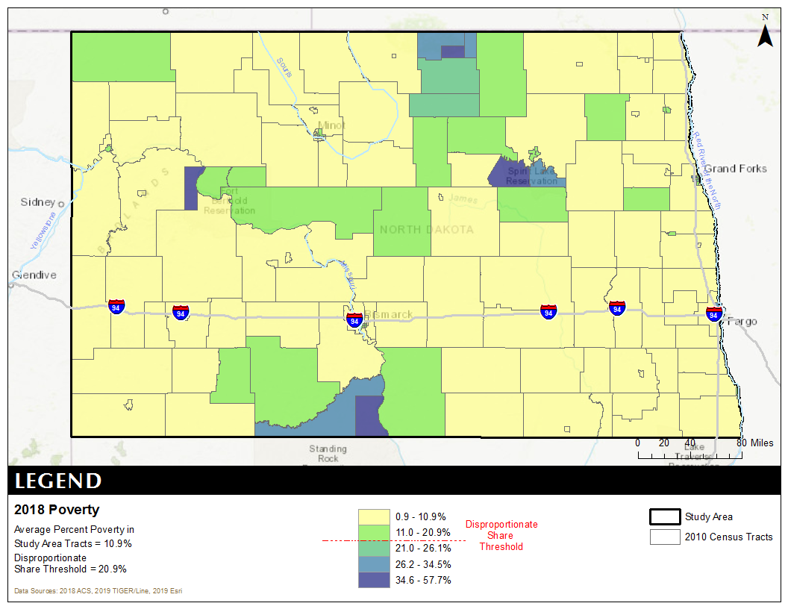
Poverty

Slide 14
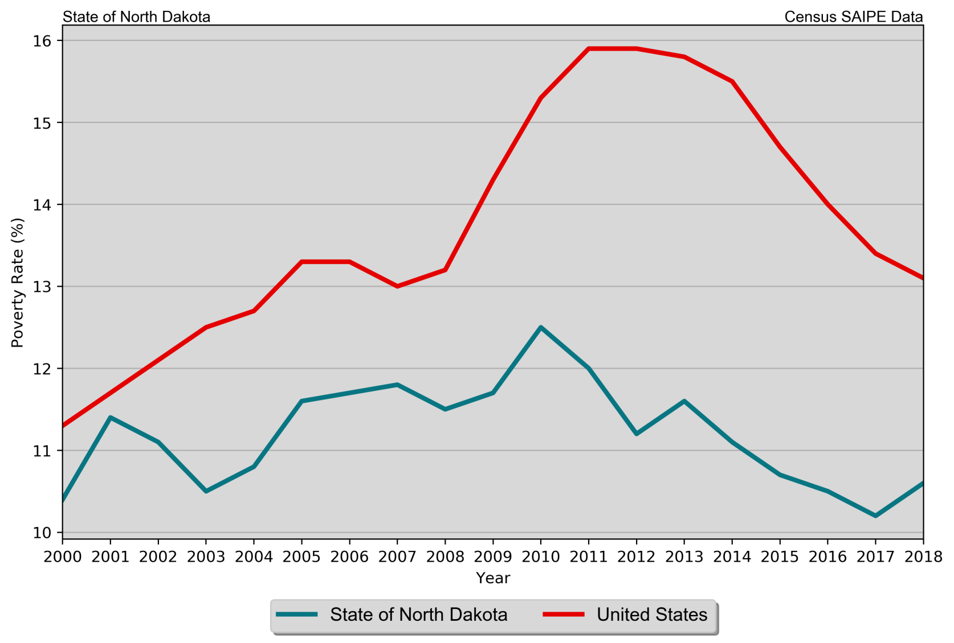
Economics
Poverty Rates
State of North Dakota
SAIPE Estimates 2000 – 2017

Slide 15
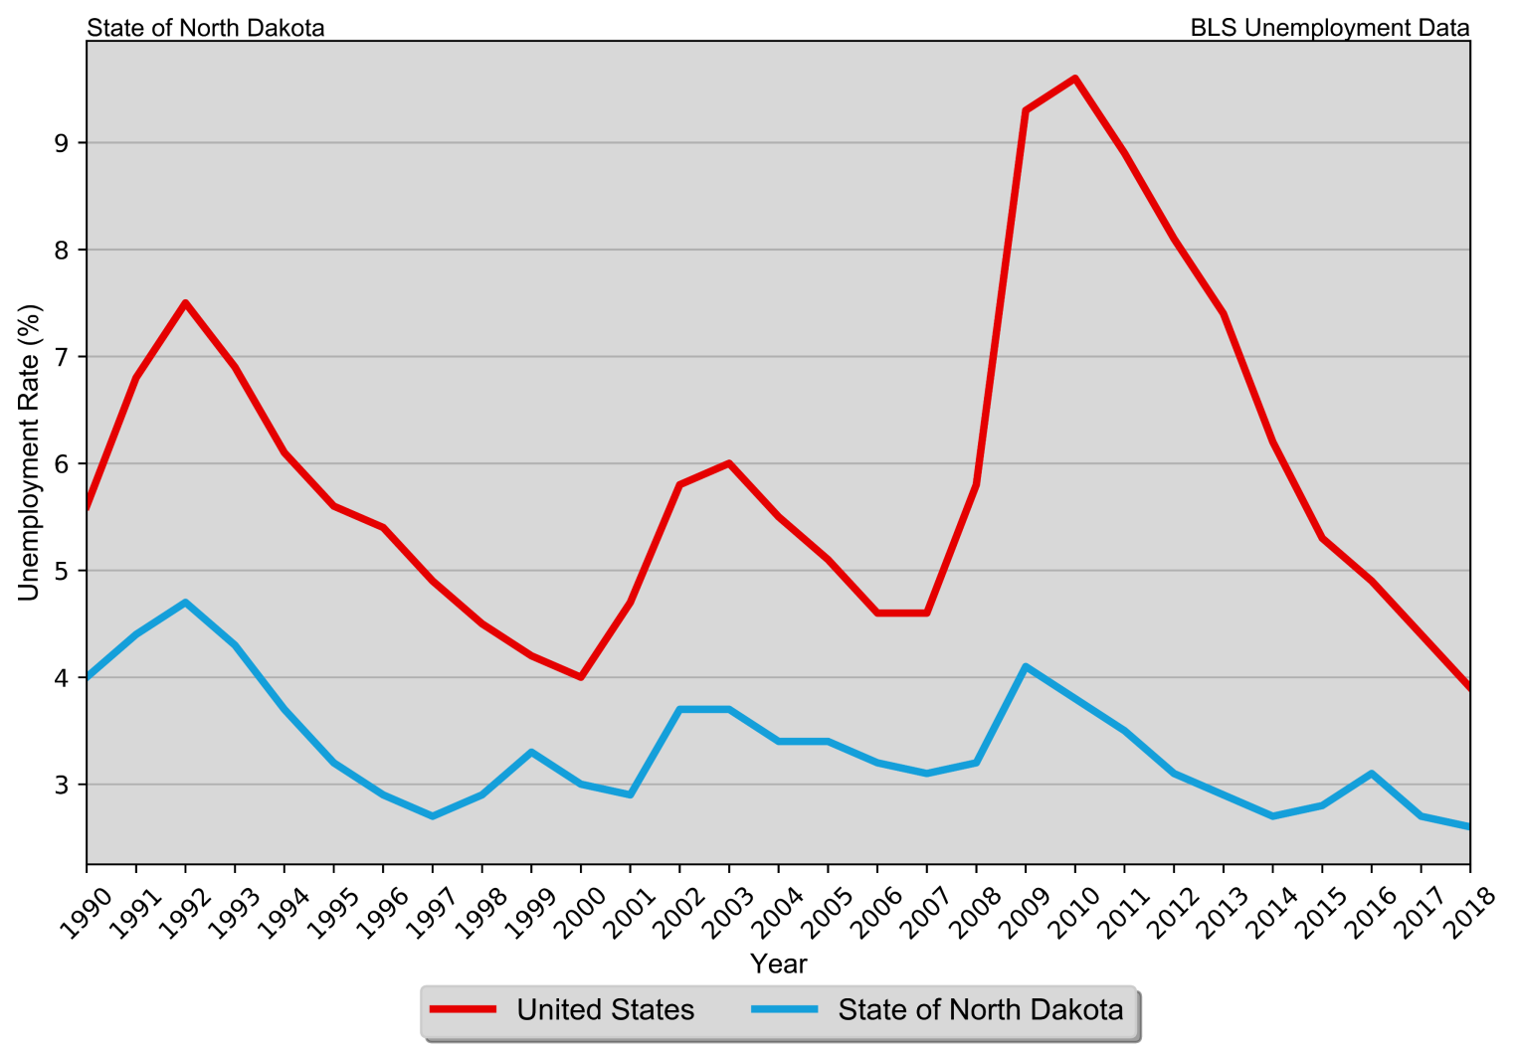
Economics
Annual Unemployment Rate
State of North Dakota
1990 – 2018 BLS Data

Slide 16
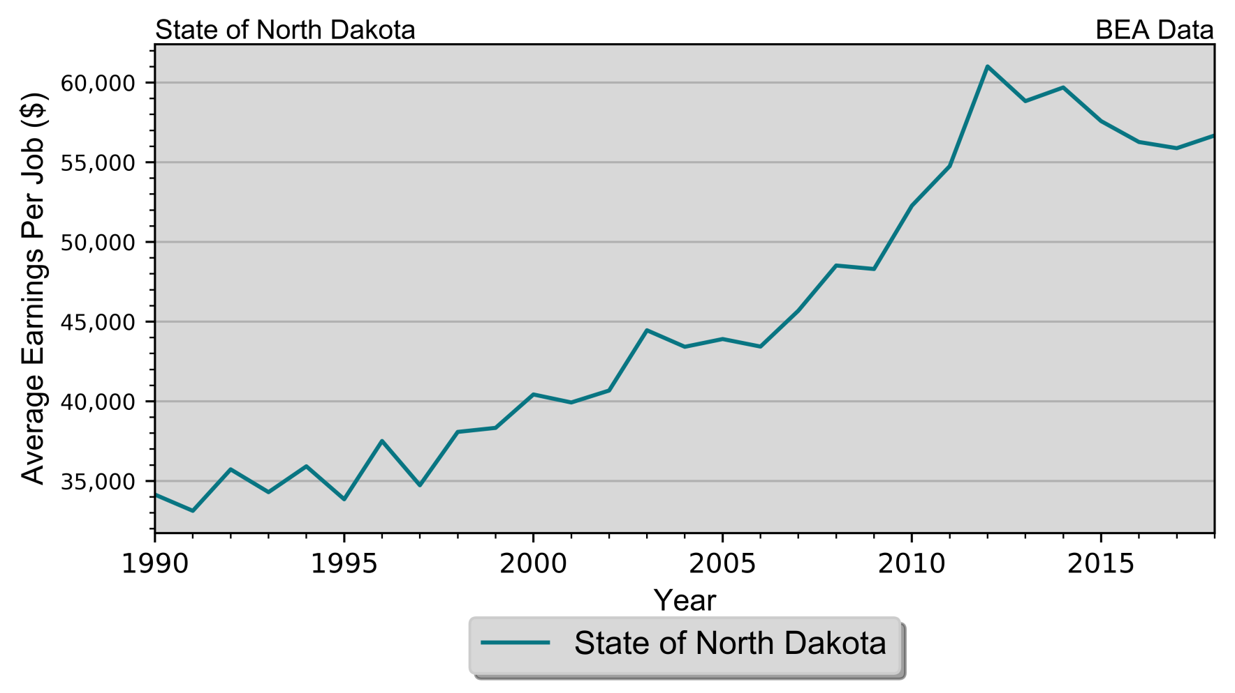
Economics
Real Average Earnings per Job
State of North Dakota

Slide 17
Housing
Housing Units by Type State of North Dakota 2010 & 2018 Five-Year ACS Data
Unit Type | 2010 Five-Year ACS |  | 2018 Five-Year ACS
 | Units | % of Total | Units | % of Total
Single-Family | 208,028 | 66.5% | 231,666 | 63.0%
Duplex | 7,192 | 2.3% | 7,608 | 2.1%
Tri- or Four-Plex | 12,538 | 4.0% | 14,120 | 3.8%
Apartment | 61,360 | 19.6% | 87,402 | 23.8%
Mobile Home | 23,719 | 7.6% | 26,767 | 7.3%
Boat, RV, Van, Etc. | 24 | 0% | 121 | 0%
Total | 312,861 | 100.0% | 367,684 | 100.0%

Slide 18
Housing
Housing Units by Tenure State of North Dakota 2010 Census & 2018 Five-Year ACS Data
Tenure | 2010 Census |  | 2018 Five-Year ACS
 | Units | % of Total | Units | % of Total
Occupied Housing Units | 281,192 | 88.6% | 314,903 | 85.6%
Owner-Occupied | 183,943 | 65.4% | 197,347 | 62.7%
Renter-Occupied | 97,249 | 34.6% | 117,556 | 37.3%
Vacant Housing Units | 36,306 | 11.4% | 52,781 | 14.4%
Total Housing Units | 317,498 | 100.0% | 367,684 | 100.0%

Slide 19
Housing
Households by Year Home Built State of North Dakota 2010 & 2018 Five-Year ACS Data
Year Built | 2010 Five-Year ACS |  | 2018 Five-Year ACS
 | Households | % of Total | Households | % of Total
1939 or Earlier | 44,468 | 16.1% | 38,564 | 12.2%
1940 to 1949 | 13,577 | 4.9% | 13,239 | 4.2%
1950 to 1959 | 29,365 | 10.6% | 28,124 | 8.9%
1960 to 1969 | 30,162 | 10.9% | 28,934 | 9.2%
1970 to 1979 | 61,690 | 22.3% | 57,926 | 18.4%
1980 to 1989 | 36,021 | 13.0% | 36,404 | 11.6%
1990 to 1999 | 32,465 | 11.7% | 35,167 | 11.2%
2000 to 2009 | 28,894 | 10.4% | 38,431 | 12.2%
2010 or Later | . | . | 38,114 | 12.1%
Total | 276,642 | 100.0% | 314,903 | 100.0%

Slide 20
Housing
Disposition of Vacant Housing Units State of North Dakota 2010 Census & 2018 Five-Year ACS Data
Disposition | 2010 Census |  | 2018 Five-Year ACS
 | Units | % of Total | Units | % of Total
For Rent | 7,422 | 20.4% | 12,502 | 23.7%
For Sale | 2,734 | 7.5% | 3,054 | 5.8%
Rented Not Occupied | 554 | 1.5% | 2,694 | 5.1%
Sold Not Occupied | 1,043 | 2.9% | 1,297 | 2.5%
For Seasonal, Recreational, or Occasional Use | 11,483 | 31.6% | 15,898 | 30.1%
For Migrant Workers | 319 | 0.9% | 858 | 1.6%
Other Vacant | 12,751 | 35.1% | 16,478 | 31.2%
Total | 36,306 | 100.0% | 52,781 | 100.0%

Slide 21
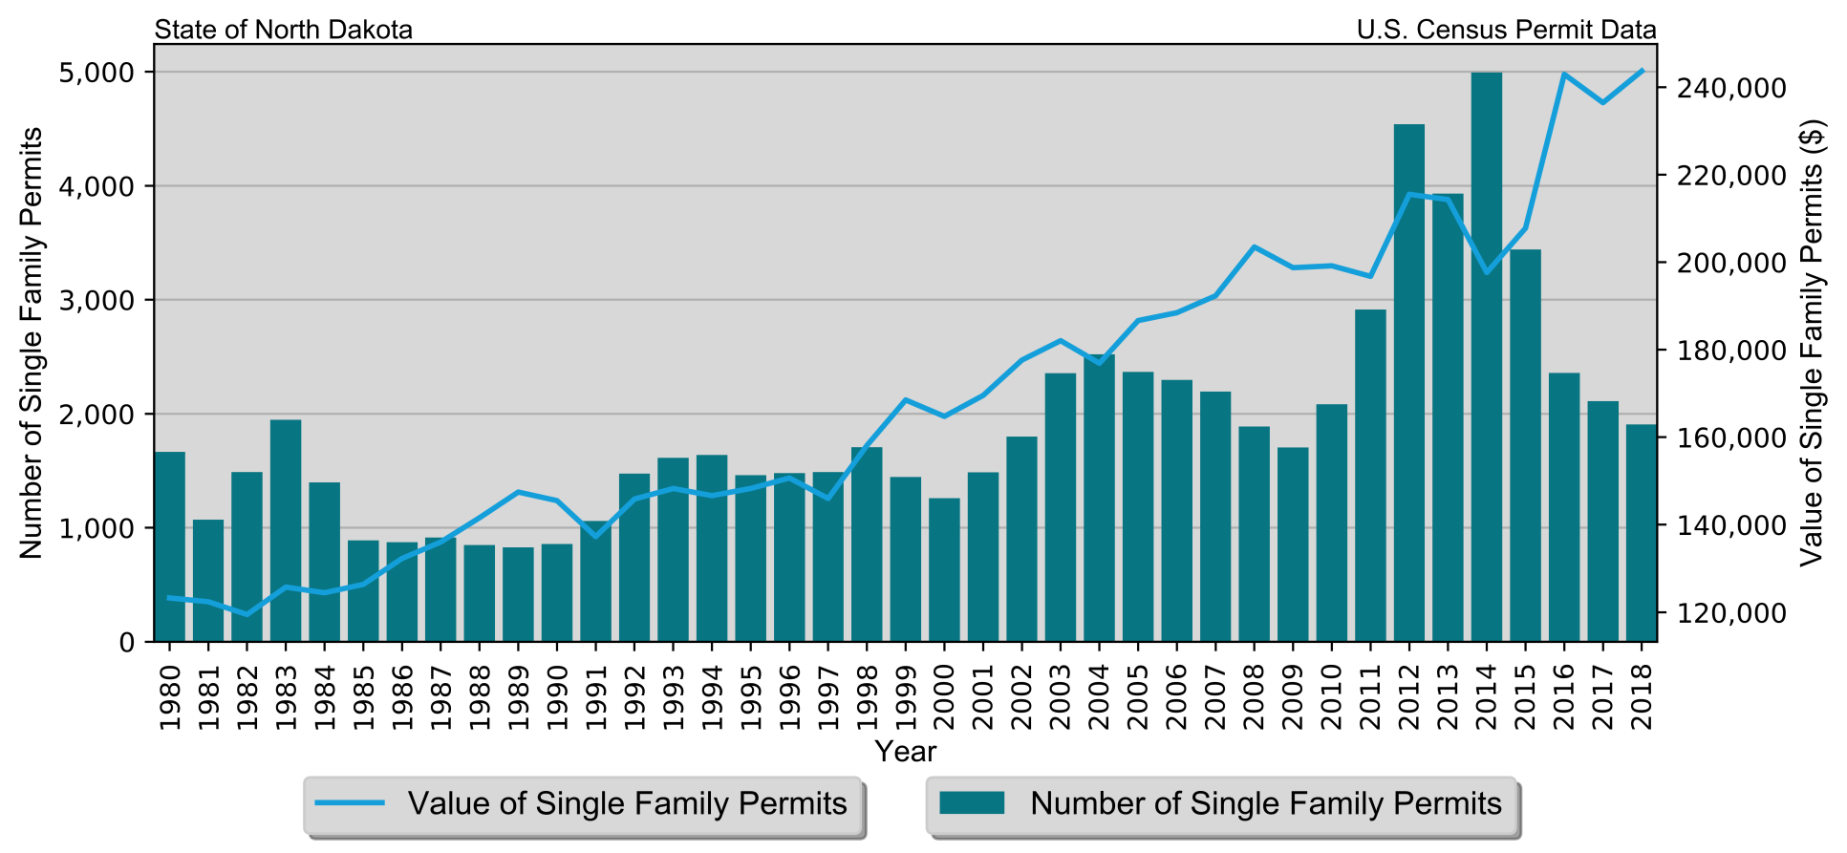
Housing
Single-Family Permits
State of North Dakota
Census Bureau Data, 1980–2018

Slide 22
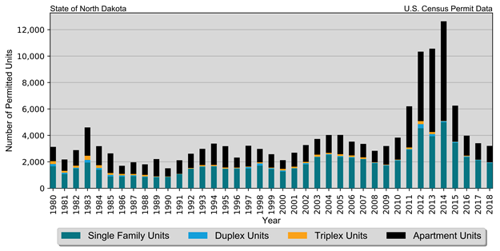
Housing
Total Permits by Unit Type
State of North Dakota
Census Bureau Data, 1980–2018

Slide 23
Housing
Median Rent State of North Dakota 2018 Five-Year ACS Data
Place | Rent
Median Rent | $722
Median Home Value | $185,000

Slide 24
Housing Problems
Households are considered to have housing problems if they have one of more of the four problems:
1. Housing unit lacks complete kitchen facilities;
2. Housing unit lacks complete plumbing facilities;
3. Household is overcrowded; and
4. Household is cost burdened.
Overcrowding and Severe Overcrowding
State of North Dakota
2010 & 2018 Five-Year ACS Data
Data Source | Overcrowding |  | Severe Overcrowding |  | Total
 | Households | % of Total | Households | % of Total
Total
2010 Five-Year ACS | 2,417 | 0.90% | 542 | 0.20% | 276,642
2018 Five-Year ACS | 4,111 | 1.30% | 2,246 | 0.70% | 314,903

Slide 25
Housing Problems
Households with Incomplete Plumbing Facilities State of North Dakota 2010 and 2018 Five-Year ACS Data
Households | 2010 Five-Year ACS | 2018 Five-Year ACS
With Complete Plumbing Facilities | 275,922 | 313,751
Lacking Complete Plumbing Facilities | 720 | 1,152
Total Households | 276,642 | 314,903
Percent Lacking | 0.3% | 0.4%
Households with Incomplete Kitchen Facilities State of North Dakota 2010 and 2018 Five-Year ACS Data
Households | 2010 Five-Year ACS | 2018 Five-Year ACS
With Complete Kitchen Facilities | 274,894 | 312,730
Lacking Complete Kitchen Facilities | 1,748 | 2,173
Total Households | 276,642 | 314,903
Percent Lacking | 0.6% | 0.7%

Slide 26
Housing Problems
Cost Burden and Severe Cost Burden by Tenure
State of North Dakota
2010 & 2018 Five-Year ACS Data
Data Source | 31%-50% Cost Burden |  | Above 50% Severe Cost Burden |  | Total
 | Households | % of Total | Households | % of Total
Owner With a Mortgage
2010 Five-Year ACS | 15,888 | 15.80% | 5,981 | 5.90% | 100,620
2018 Five-Year ACS | 12,073 | 11.50% | 5,573 | 5.30% | 104,979
Owner Without a Mortgage
2010 Five-Year ACS | 5,927 | 7.10% | 4,307 | 5.20% | 83,497
2018 Five-Year ACS | 4,466 | 4.80% | 3,968 | 4.30% | 92,368
Renter
2010 Five-Year ACS | 16,711 | 18.10% | 17,299 | 18.70% | 92,525
2018 Five-Year ACS | 21,605 | 18.40% | 20,358 | 17.30% | 117,556
Total
2010 Five-Year ACS | 38,526 | 13.90% | 27,587 | 10.00% | 276,642
2018 Five-Year ACS | 38,144 | 12.10% | 29,899 | 9.50% | 314,903

Slide 27
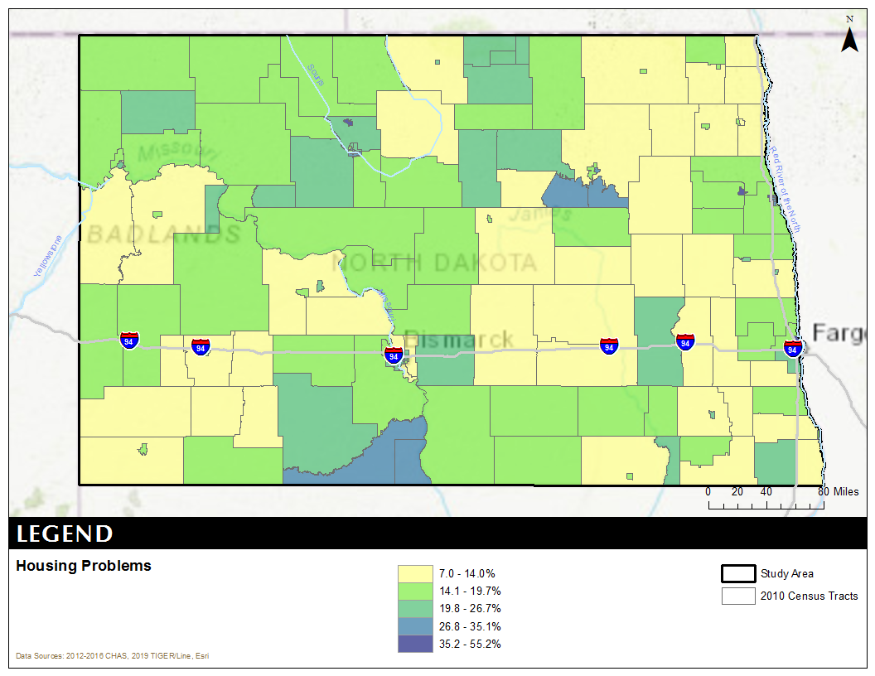
Housing Problems
Housing Problems include:
Overcrowding
Incomplete kitchen fixtures
Incomplete plumbing fixtures
Cost Burdens

Slide 28
Housing Problems
Percent of Total Households with Housing Problems by Income and Race State of North Dakota 2012–2016 HUD CHAS Data
Income | Non-Hispanic by Race |  |  |  |  |  | Hispanic (Any Race) | Total
 | White | Black | Asian | American Indian | Pacific Islander | Other Race
With Housing Problems
$0 to $25,350 | 70.7% | 80.6% | 65.1% | 65.8% | 100.0% | 66.2% | 82.4% | 70.9%
$25,351 to $42,250 | 47.2% | 62.6% | 66.7% | 45.3% | 0% | 63.6% | 64.2% | 48.7%
$42,251 to $67,600 | 20.6% | 23.1% | 23.9% | 16.3% | 0% | 25.4% | 32.4% | 21.0%
$67,601 to $84,500 | 9.9% | 38.2% | 4.6% | 6.1% | 0% | 15.7% | 10.8% | 10.0%
Above $84,500 | 3.1% | 15.6% | 8.1% | 7.0% | 0% | 6.3% | 11.6% | 3.4%
Total | 20.2% | 50.7% | 30.8% | 35.0% | 37.5% | 30.7% | 40.6% | 22.0%
Without Housing Problems
$0 to $25,350 | 22.6% | 10.2% | 10.9% | 24.7% | 0% | 32.7% | 11.7% | 22.0%
$25,351 to $42,250 | 52.8% | 37.4% | 33.3% | 54.7% | 0% | 36.4% | 35.8% | 51.3%
$42,251 to $67,600 | 79.4% | 76.9% | 76.1% | 83.7% | 0% | 74.6% | 67.6% | 79.0%
$67,601 to $84,500 | 90.1% | 61.8% | 95.4% | 93.9% | 100.0% | 84.3% | 89.2% | 90.0%
Above $84,500 | 96.9% | 84.4% | 91.9% | 93.0% | 100.0% | 93.7% | 88.4% | 96.6%
Total | 79.0% | 46.5% | 64.2% | 61.8% | 62.5% | 69.2% | 58.2% | 77.1%

Slide 29
Housing Problems
Total Households with Housing Problems by Income and Race State of North Dakota 2012–2016 HUD CHAS Data
Income | Non-Hispanic by Race |  |  |  |  |  |  |  | Hispanic (Any Race) | Total
 | White | Black | Asian | American Indian | Pacific Islander | Pacific Islander | Other Race | Other Race
With Housing Problems
$0 to $25,350 | 23,005 | 1,310 | 420 | 2,465 | 15 |  | 485 |  | 1,095 | 28,795
$25,351 to $42,250 | 14,900 | 820 | 320 | 865 | 0 |  | 420 |  | 735 | 18,060
$42,251 to $67,600 | 10,630 | 295 | 94 | 335 | 0 |  | 255 |  | 565 | 12,174
$67,601 to $84,500 | 3,120 | 105 | 8 | 60 | 0 |  | 80 |  | 70 | 3,443
Above $84,500 | 3,915 | 115 | 115 | 170 | 0 |  | 90 |  | 195 | 4,600
Total | 55,570 | 2,645 | 957 | 3,895 | 15 |  | 1,330 |  | 2,660 | 67,072
Total
$0 to $25,350 | 32,535 | 1,625 | 645 | 3,745 | 15 |  | 733 |  | 1,329 | 40,627
$25,351 to $42,250 | 31,595 | 1,310 | 480 | 1,910 | 0 |  | 660 |  | 1,145 | 37,100
$42,251 to $67,600 | 51,545 | 1,275 | 394 | 2,050 | 0 |  | 1,005 |  | 1,745 | 58,014
$67,601 to $84,500 | 31,665 | 275 | 173 | 990 | 10 |  | 510 |  | 650 | 34,273
Above $84,500 | 127,480 | 735 | 1,415 | 2,420 | 15 |  | 1,430 |  | 1,680 | 135,175
Total | 274,820 | 5,220 | 3,107 | 11,115 | 40 |  | 4,338 |  | 6,549 | 305,189

Slide 30
Priority Needs:
Affordable Rental Housing
Affordable Homeowner Housing
Homelessness
Vital Public Facilities
Special Needs Populations
Economic Development
Priority Infrastructure

Slide 31
5 Year Goals:
Increase Access to Affordable Housing
The State will use HOME, CDBG and Housing Trust Fund to increase affordable housing through the construction of new rental housing, the rehabilitations of rental housing and the rehabilitation of owner housing. HOME can be used for down payment and closing cost assistance for first-time homebuyers.

Slide 32
5 Year Goals:
Support Efforts to Combat Homelessness
The State will combat homelessness through the support of emergency shelters, transitional housing and permanent supportive housing, Tenant-based Rental Assistance (TBRA) for those at risk of homelessness, homeless prevention activities, and data collection.

Slide 33
5 Year Goals:
Support Public Facilities and Services
The State will support public facility improvements, including facilities for childcare facilities, recycling centers/services, and demolition of dilapidated structures, as well as any facilities rated as high or low in NA-50. This can also include increasing access to public services for special needs and low to moderate income households. This includes, but is not limited to, childcare, mental health care services, and chemical dependency services.

Slide 34
5 Year Goals:
Encourage Economic Development
This goal provides employment opportunities for low- and moderate-income people and promotes businesses in the State.

Slide 35
5 Year Goals:
Encourage Economic Development
This goal provides employment opportunities for low- and moderate-income people and promotes businesses in the State.
Enhance Local Public Infrastructure and Planning
This goal will fund public infrastructure, such as, but not limited to, water systems, streets, sidewalks, and other vital public facilities. This also includes local strategic planning funding.

Slide 36
Consolidated Plan
Contact:
Bonnie Malo
Director
Division of Community Services
701.328.2476
bmalo@nd.gov

