Slide 1
2020-2024 State of North Dakota
Analysis of Impediments
Sponsored by
North Dakota Department of Commerce
Welcome to the
Public Review Meeting!
April 21, 2020

Slide 2
Fair Housing Protections
  Fair Housing Protections
  Federal and State Fair Housing Acts protect several groups in housing transactions. These are:
  Race, color, religion, national origin, sex, disability, and familial status

Slide 3
North Dakota Analysis of Impediments (AI)
  Entitlement jurisdictions must:
  Certify that they are affirmatively furthering fair housing (AFFH) as a condition of receiving federal funds for housing from HUD

Slide 4
HUD’s Fair Housing Issues
  1. Segregation analysis
  2. RCAP and ECAP evaluation
  3. Disparities in access to opportunity
  4. Disproportionate housing needs
  5. Publicly supported housing analysis
  6. Disability and access analysis
  7. Fair housing enforcement, outreach, etc.
RCAP: Racially Concentrated Areas of Poverty
ECAP: Ethnically Concentrated Areas of Poverty

Slide 5
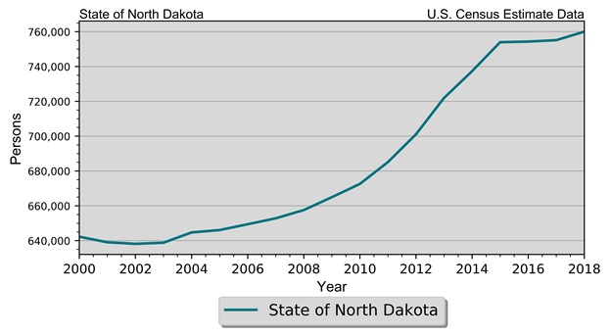
Demographics
Population Estimates State of North Dakota 2010-2018 Census Data and Intercensal Estimates
2010 Census | 672,591
2011 Population Estimate | 685,136
2012 Population Estimate | 701,116
2013 Population Estimate | 721,999
2014 Population Estimate | 737,382
2015 Population Estimate | 754,022
2016 Population Estimate | 754,353
2017 Population Estimate | 755,176
2018 Population Estimate | 760,077

Slide 6
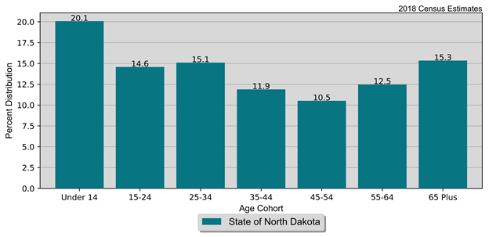
Demographics
Population by Age and Gender
State of North Dakota
2010 Census and Current Census Estimates
Age | 2010 Census | 2018 Estimates | % Change
 |  |  | 18-Oct
Under 14 years | 124,461 | 152,549 | 22.60%
15 to 24 years | 106,430 | 110,861 | 4.20%
25 to 44 years | 90,485 | 114,800 | 26.90%
45 to 54 years | 75,262 | 90,402 | 20.10%
55 to 64 years | 96,657 | 80,005 | -17.20%
65 and Over | 81,819 | 94,823 | 15.90%
Total | 672,591 | 760,077 | 13.00%

Slide 7
Demographics
Population by Race and Ethnicity State of North Dakota 2010 Census & 2018 Five-Year ACS
Race | 2010 Census |  | 2018 Five-Year ACS
 | Population | % of Total | Population | % of Total
White | 605,449 | 90.0% | 655,268 | 87.1%
Black | 7,960 | 1.2% | 20,445 | 2.7%
American Indian | 36,591 | 5.4% | 39,462 | 5.2%
Asian | 6,909 | 1.0% | 10,814 | 1.4%
Native Hawaiian/ Pacific Islander | 320 | 0% | 378 | 0.1%
Other | 3,509 | 0.5% | 7,528 | 1.0%
Two or More Races | 11,853 | 1.8% | 18,306 | 2.4%
Total | 672,591 | 100.0% | 752,201 | 100.0%
Non-Hispanic | 659,124 | 98.0% | 725,672 | 96.5%
Hispanic | 13,467 | 2.0% | 26,529 | 3.5%

Slide 8
Economics
Households by Income State of North Dakota 2010 & 2018 Five-Year ACS Data
Income | 2010 Five-Year ACS |  | 2018 Five-Year ACS
 | Households | % of Total | Households | % of Total
Less than $15,000 | 39,425 | 14.3% | 31,291 | 9.9%
$15,000 to $19,999 | 16,011 | 5.8% | 13,158 | 4.2%
$20,000 to $24,999 | 16,678 | 6.0% | 12,633 | 4.0%
$25,000 to $34,999 | 32,772 | 11.8% | 27,910 | 8.9%
$35,000 to $49,999 | 41,563 | 15.0% | 39,929 | 12.7%
$50,000 to $74,999 | 55,089 | 19.9% | 57,047 | 18.1%
$75,000 to $99,999 | 34,795 | 12.6% | 45,061 | 14.3%
$100,000 or More | 40,309 | 14.6% | 87,874 | 27.9%
Total | 276,642 | 100.0% | 314,903 | 100.0%

Slide 9
Economics
Poverty by Age State of North Dakota 2000 Census SF3 & 2018 Five-Year ACS Data
Age | 2000 Census |  | 2018 Five-Year ACS
 | Persons in Poverty | % of Total | Persons in Poverty | % of Total
Under 6 | 8,173 | 11.1% | 8,604 | 10.9%
6 to 17 | 13,990 | 19.0% | 12,258 | 15.5%
18 to 64 | 41,568 | 56.6% | 48,920 | 61.7%
65 or Older | 9,726 | 13.2% | 9,488 | 12.0%
Total | 73,457 | 100.0% | 79,270 | 100.0%
Poverty Rate | 11.9% | . | 10.9% | .

Slide 10
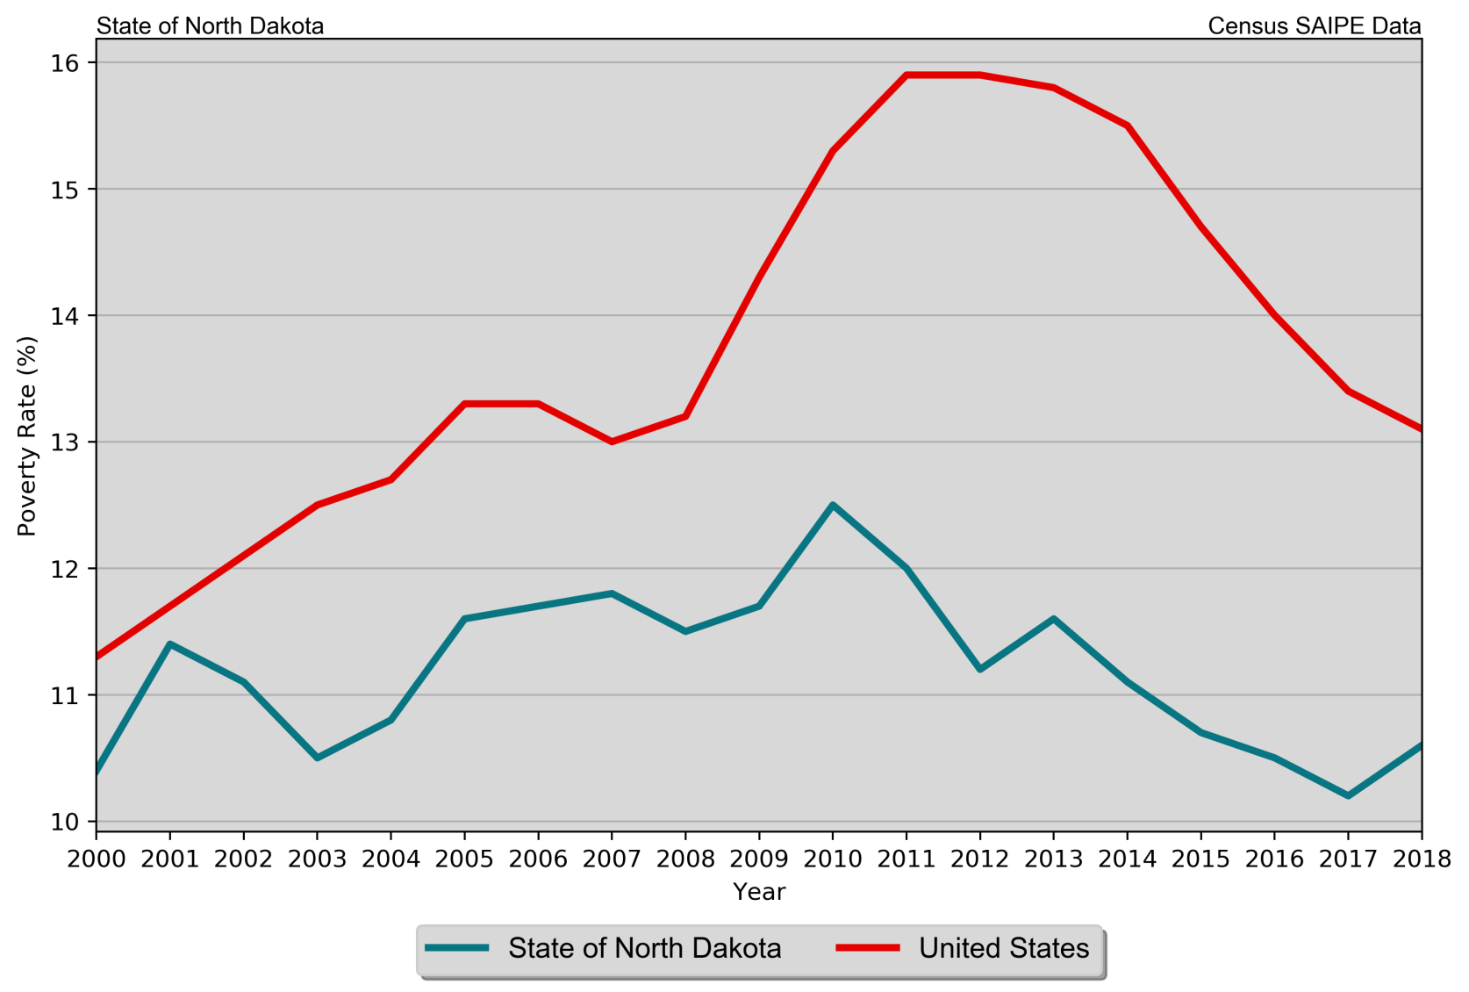
Economics
Poverty Rates
State of North Dakota
SAIPE Estimates 2000 – 2017

Slide 11
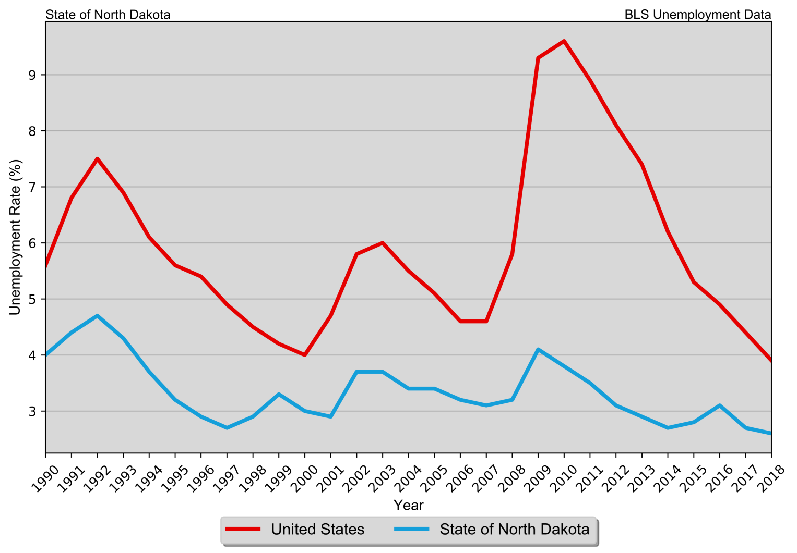
Economics
Annual Unemployment Rate
State of North Dakota
1990 – 2018 BLS Data

Slide 12
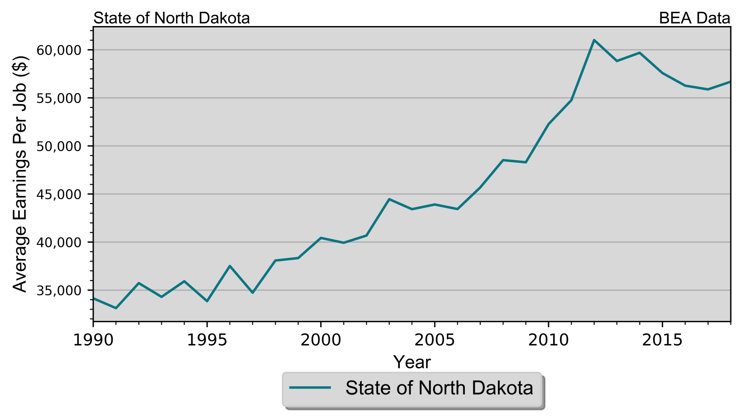
Economics
Real Average Earnings per Job
State of North Dakota

Slide 13
Housing
Housing Units by Type State of North Dakota 2010 & 2018 Five-Year ACS Data
Unit Type | 2010 Five-Year ACS |  | 2018 Five-Year ACS
 | Units | % of Total | Units | % of Total
Single-Family | 208,028 | 66.5% | 231,666 | 63.0%
Duplex | 7,192 | 2.3% | 7,608 | 2.1%
Tri- or Four-Plex | 12,538 | 4.0% | 14,120 | 3.8%
Apartment | 61,360 | 19.6% | 87,402 | 23.8%
Mobile Home | 23,719 | 7.6% | 26,767 | 7.3%
Boat, RV, Van, Etc. | 24 | 0% | 121 | 0%
Total | 312,861 | 100.0% | 367,684 | 100.0%

Slide 14
Housing
Housing Units by Tenure State of North Dakota 2010 Census & 2018 Five-Year ACS Data
Tenure | 2010 Census |  | 2018 Five-Year ACS
 | Units | % of Total | Units | % of Total
Occupied Housing Units | 281,192 | 88.6% | 314,903 | 85.6%
Owner-Occupied | 183,943 | 65.4% | 197,347 | 62.7%
Renter-Occupied | 97,249 | 34.6% | 117,556 | 37.3%
Vacant Housing Units | 36,306 | 11.4% | 52,781 | 14.4%
Total Housing Units | 317,498 | 100.0% | 367,684 | 100.0%

Slide 15
Housing
Households by Year Home Built State of North Dakota 2010 & 2018 Five-Year ACS Data
Year Built | 2010 Five-Year ACS |  | 2018 Five-Year ACS
 | Households | % of Total | Households | % of Total
1939 or Earlier | 44,468 | 16.1% | 38,564 | 12.2%
1940 to 1949 | 13,577 | 4.9% | 13,239 | 4.2%
1950 to 1959 | 29,365 | 10.6% | 28,124 | 8.9%
1960 to 1969 | 30,162 | 10.9% | 28,934 | 9.2%
1970 to 1979 | 61,690 | 22.3% | 57,926 | 18.4%
1980 to 1989 | 36,021 | 13.0% | 36,404 | 11.6%
1990 to 1999 | 32,465 | 11.7% | 35,167 | 11.2%
2000 to 2009 | 28,894 | 10.4% | 38,431 | 12.2%
2010 or Later | . | . | 38,114 | 12.1%
Total | 276,642 | 100.0% | 314,903 | 100.0%

Slide 16
Housing
Disposition of Vacant Housing Units State of North Dakota 2010 Census & 2018 Five-Year ACS Data
Disposition | 2010 Census |  | 2018 Five-Year ACS
 | Units | % of Total | Units | % of Total
For Rent | 7,422 | 20.4% | 12,502 | 23.7%
For Sale | 2,734 | 7.5% | 3,054 | 5.8%
Rented Not Occupied | 554 | 1.5% | 2,694 | 5.1%
Sold Not Occupied | 1,043 | 2.9% | 1,297 | 2.5%
For Seasonal, Recreational, or Occasional Use | 11,483 | 31.6% | 15,898 | 30.1%
For Migrant Workers | 319 | 0.9% | 858 | 1.6%
Other Vacant | 12,751 | 35.1% | 16,478 | 31.2%
Total | 36,306 | 100.0% | 52,781 | 100.0%

Slide 17
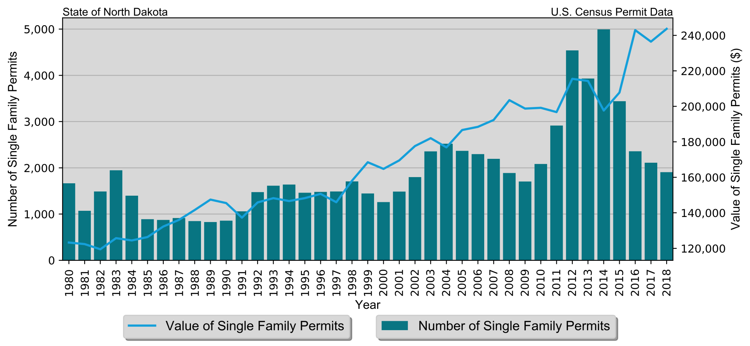
Housing
Single-Family Permits
State of North Dakota
Census Bureau Data, 1980–2018

Slide 18
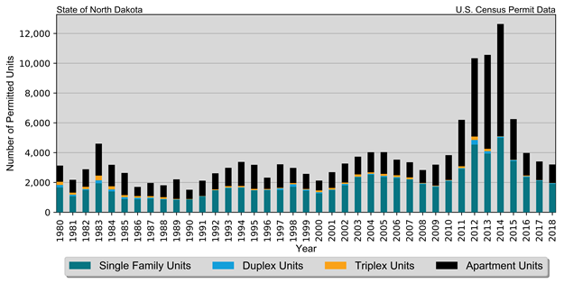
Housing
Total Permits by Unit Type
State of North Dakota
Census Bureau Data, 1980–2018

Slide 19
Housing
Median Rent State of North Dakota 2018 Five-Year ACS Data
Place | Rent
Median Rent | $722
Median Home Value | $185,000

Slide 20
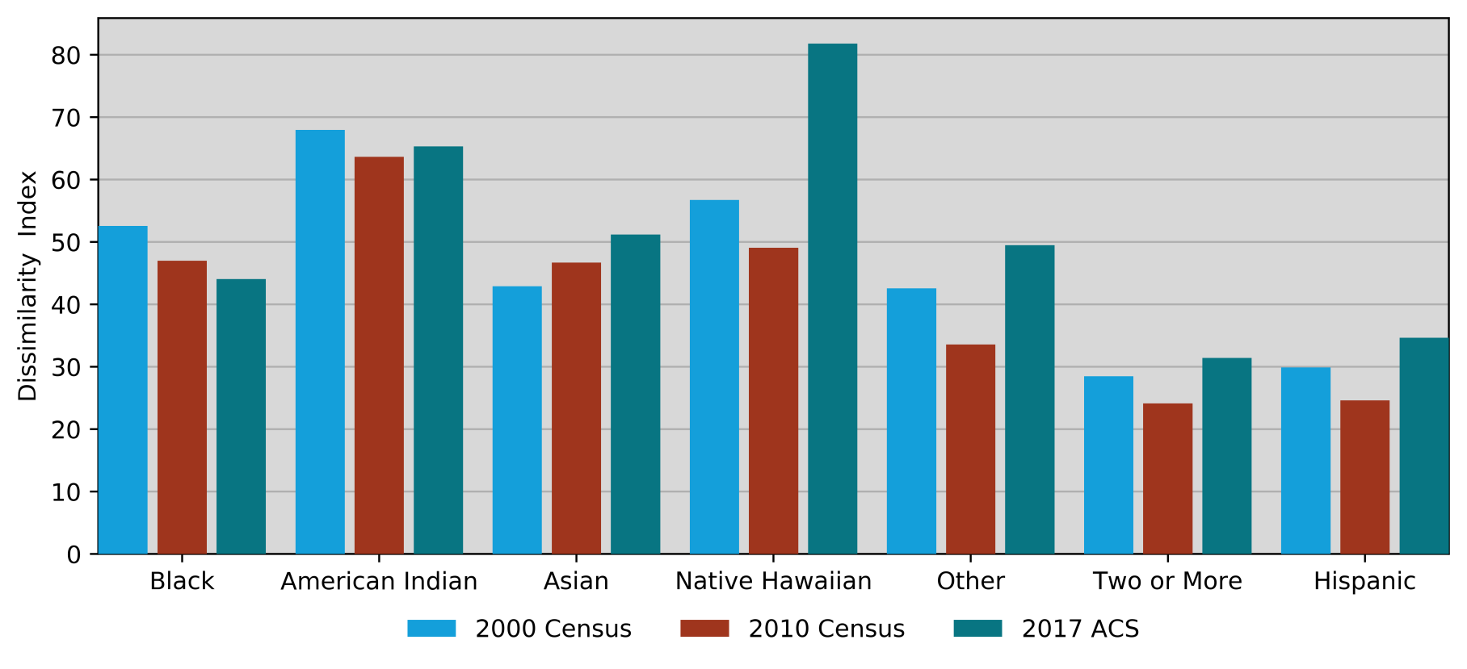
Segregation
Interpreting the dissimilarity index
Measure | Values | Description
Dissimilarity Index | <40 | Low Segregation
[range 0-100] | 40-54 | Moderate Segregation
 | >55 | High Segregation
Dissimilarity Index
State of North Dakota

Slide 21
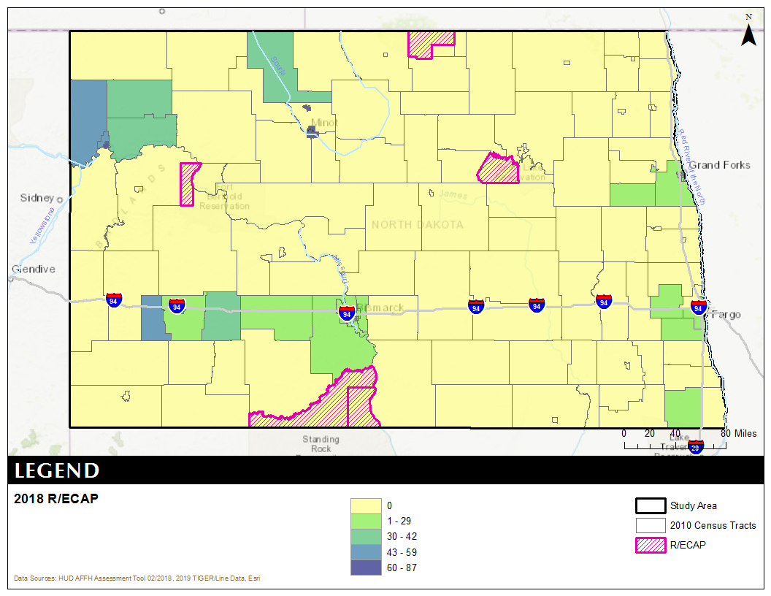
R/ECAPs

Slide 22
Disparities in Access to Opportunity
Access to Opportunity Indexes
Low Poverty – a measure of the degree of poverty in a neighborhood
School Proficiency - school-level data on the performance of 4th grade students on state exams to describe which neighborhoods have high-performing elementary schools
Jobs Proximity - quantifies the accessibility of a given residential neighborhood as a function of its distance to all job locations

Slide 23
Disparities in Access to Opportunity
Access to Opportunity Indexes
Labor Market Engagement - provides a summary description of the relative intensity of labor market engagement and human capital in a neighborhood
Low Transportation Cost – estimates of transportation costs for a family that meets the following description: a 3-person single-parent family with income at 50% of the median income for renters for the region
Transit Trips - trips taken by a family that meets the following description: a 3-person single-parent family with income at 50% of the median income for renters
Environmental Health - summarizes potential exposure to harmful toxins at a neighborhood level

Slide 24
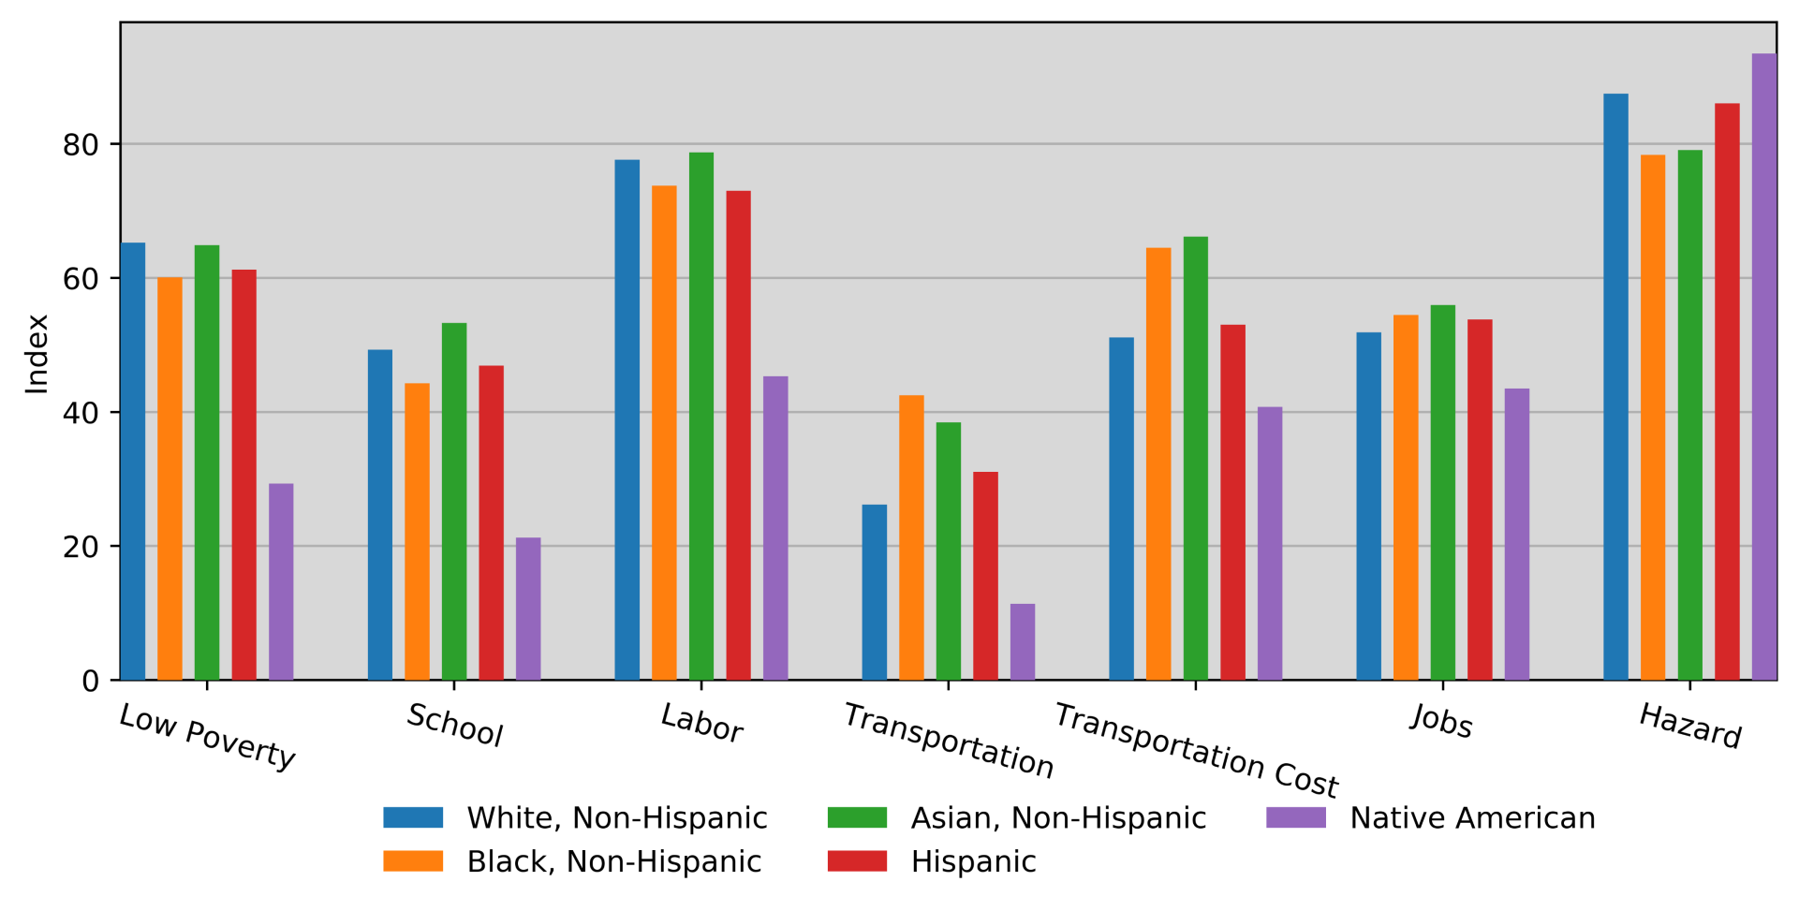
Disparities in Access to Opportunity
Access to Opportunity Indexes

Slide 25
Disparities in Access to Opportunity
Mortgage Denial Rates by Race/Ethnicity of Applicant State of North Dakota 2004–2017 HMDA Data
Race/Ethnicity | 2008 | 2009 | 2010 | 2011 | 2012 | 2013 | 2014 | 2015 | 2016 | 2017 | 2018 | Average
American Indian | 19.5% | 16.7% | 25.5% | 20.8% | 25.0% | 28.6% | 18.6% | 23.1% | 14.0% | 10.0% | 16.1% | 19.4%
Asian | 3.6% | 8.8% | 8.0% | 7.9% | 18.4% | 9.0% | 4.8% | 7.5% | 8.5% | 10.8% | 10.7% | 9.0%
Black | 15.9% | 17.0% | 3.1% | 11.8% | 17.5% | 7.5% | 11.6% | 21.7% | 20.0% | 21.6% | 7.5% | 14.8%
Pacific Islander | 10.0% | 11.1% | 18.2% | 0.0% | 6.2% | 13.3% | 21.7% | 4.8% | 16.7% | 0.0% | 0.0% | 10.2%
White | 8.1% | 8.5% | 8.5% | 9.4% | 9.9% | 9.1% | 7.4% | 8.4% | 7.9% | 7.1% | 5.4% | 8.2%
Not Available | 14.4% | 11.7% | 13.1% | 20.4% | 18.0% | 17.8% | 21.2% | 16.6% | 19.0% | 18.8% | 10.9% | 16.2%
Not Applicable | 0.0% | 0.0% | % | % | 0.0% | 0.0% | 0.0% | 0.0% | 0.0% | 0.0% | 0.0% | 0.0%
Average | 8.5% | 8.8% | 8.7% | 9.9% | 10.4% | 9.6% | 8.1% | 9.0% | 8.6% | 7.9% | 6.0% | 8.7%
Hispanic | 15.5% | 20.5% | 6.3% | 15.1% | 21.1% | 16.7% | 7.1% | 13.8% | 7.1% | 10.7% | 10.1% | 12.6%
Non-Hispanic | 8.2% | 8.5% | 8.6% | 9.3% | 10.1% | 9.1% | 7.6% | 8.6% | 8.1% | 7.3% | 5.4% | 8.3%

Slide 26
Disproportionate Housing Needs
Percent of Total Households with Housing Problems by Income and Race
State of North Dakota
2012–2016 HUD CHAS Data
Income | Non-Hispanic by Race |  |  |  |  |  | Hispanic | Total
 | White | Black | Asian | American | Pacific | Other Race | (Any Race)
 |  |  |  | Indian | Islander
With Housing Problems
$0 to $25,350 | 70.7% | 80.6% | 65.1% | 65.8% | 100.0% | 66.2% | 82.4% | 70.9%
$25,351 to $42,250 | 47.2% | 62.6% | 66.7% | 45.3% | 0% | 63.6% | 64.2% | 48.7%
$42,251 to $67,600 | 20.6% | 23.1% | 23.9% | 16.3% | 0% | 25.4% | 32.4% | 21.0%
$67,601 to $84,500 | 9.9% | 38.2% | 4.6% | 6.1% | 0% | 15.7% | 10.8% | 10.0%
Above $84,500 | 3.1% | 15.6% | 8.1% | 7.0% | 0% | 6.3% | 11.6% | 3.4%
Total | 20.2% | 50.7% | 30.8% | 35.00% | 37.50% | 30.70% | 40.6% | 22.0%
Without Housing Problems
$0 to $25,350 | 22.6% | 10.2% | 10.9% | 24.7% | 0.0% | 32.7% | 11.7% | 22.0%
$25,351 to $42,250 | 52.8% | 37.4% | 33.3% | 54.7% | 0.0% | 36.4% | 35.8% | 51.3%
$42,251 to $67,600 | 79.4% | 76.9% | 76.1% | 83.7% | 0.0% | 74.6% | 67.6% | 79.0%
$67,601 to $84,500 | 90.1% | 61.8% | 95.4% | 93.9% | 100.0% | 84.3% | 89.2% | 90.0%
Above $84,500 | 96.9% | 84.4% | 91.9% | 93.0% | 100.0% | 93.7% | 88.4% | 96.6%
Total | 79.0% | 46.5% | 64.2% | 61.8% | 62.5% | 69.2% | 58.2% | 77.1%

Slide 27
Disability and Access
Disability by Age State of North Dakota 2018 Five-Year ACS Data
Age | Male |  | Female |  | Total
 | Disabled Population | Disability Rate | Disabled Population | Disability Rate | Disabled Population | Disability Rate
Under 5 | 187 | 0.7% | 127 | 0.5% | 314 | 0.6%
5 to 17 | 3,847 | 6.2% | 1,689 | 2.9% | 5,536 | 4.6%
18 to 34 | 4,989 | 4.8% | 5,376 | 5.9% | 10,365 | 5.3%
35 to 64 | 15,931 | 11.8% | 12,484 | 9.7% | 28,415 | 10.8%
65 to 74 | 7,279 | 25.3% | 6,059 | 20.7% | 13,338 | 23.0%
75 or Older | 9,142 | 47.7% | 12,234 | 45.9% | 21,376 | 46.7%
Total | 41,375 | 11.0% | 37,969 | 10.5% | 79,344 | 10.8%

Slide 28
Disability and Access
Residents with Disabilities by Subsidized Housing Type State of North Dakota HUD AFFH Raw Database
Program | Total Units | Total Disabled Units
Public Housing | 1,807 | 567
Project Based Section 8 | 2,917 | 811
Other HUD Multifamily | 208 | 117
Housing Choice Vouchers | 7,879 | 2,267
Total | 12,811 | 3,762

Slide 29
Fair Housing Complaints
Fair Housing Complaints with Cause by Basis State of North Dakota HUD Fair Housing Complaints
Basis | 2008 | 2009 | 2010 | 2011 | 2012 | 2013 | 2014 | 2015 | 2016 | 2017 | 2018 | 2019 | Total
Disability | 9 | 18 | 12 | 10 | 13 | 13 | 15 | 5 | 9 | 27 | 5 | 11 | 147
Familial Status | 5 | 12 | 1 | 0 | 1 | 0 | 1 | 0 | 0 | 1 | 0 | 0 | 21
Public Assistance | 1 | 3 | 1 | 0 | 2 | 0 | 0 | 0 | 2 | 2 | 3 | 2 | 16
Race | 0 | 1 | 1 | 0 | 1 | 1 | 1 | 2 | 1 | 1 | 0 | 1 | 10
National Origin | 0 | 1 | 0 | 0 | 0 | 0 | 2 | 1 | 0 | 1 | 1 | 1 | 7
Color | 0 | 0 | 1 | 1 | 0 | 0 | 1 | 0 | 0 | 0 | 0 | 1 | 4
Sex | 0 | 0 | 0 | 0 | 0 | 0 | 1 | 1 | 1 | 0 | 0 | 0 | 3
Age | 0 | 0 | 1 | 0 | 1 | 0 | 1 | 0 | 0 | 0 | 0 | 0 | 3
Marital Status | 0 | 0 | 0 | 0 | 0 | 0 | 1 | 0 | 0 | 1 | 0 | 0 | 2
Retaliation | 0 | 0 | 0 | 0 | 0 | 0 | 0 | 0 | 0 | 1 | 0 | 0 | 1
Total Basis | 15 | 35 | 17 | 11 | 18 | 14 | 23 | 9 | 13 | 34 | 9 | 16 | 214
Total Complaints | 15 | 36 | 17 | 11 | 18 | 14 | 23 | 9 | 13 | 34 | 9 | 16 | 199

Slide 30
Fair Housing Survey
How familiar are you with fair housing laws? State of North Dakota Fair Housing Survey
Response | Total
Not Familiar | 16
Somewhat Familiar | 21
Very Familiar | 12
Missing | 16
Total | 65

Slide 31
Fair Housing Survey
Fair Housing Barriers State of North Dakota Fair Housing Survey
Question | Too Much | The Right Amount | Too Little | Don’t Know | Missing | Total
Please assess the level of fair housing outreach and education activity in the State. | 0 | 10 | 21 | 17 | 17 | 65
Please assess the current level of fair housing testing in the State. | 1 | 6 | 16 | . | 17 | 65

Slide 32
Findings:
Contributing Factors
State of North Dakota
Contributing Factors | Priority | Justification
Moderate to high levels of segregation | High | In 2017, black, American Indian, Native Hawaiian, and “other” race, households had a moderate to high level of segregation, according to the Dissimilarity Index.
Access to low poverty areas and concentrations of poverty | High | Low poverty index is markedly lower for Native American populations than white households, indicating inequitable access to low poverty areas.
Access to labor market engagement | Med | Native American households have less access to labor market engagement as indicated by the Access to Opportunity index. However, the State has little control over impacting labor market engagement on a large scale.

Slide 33
Findings:
Contributing Factors
State of North Dakota
Contributing Factors | Priority | Justification
Access to School Proficiency | Med | Native American households have lower levels of access to proficient schools.
Insufficient affordable housing in a range of unit sizes | High | Some 19.6 percent of households have cost burdens. This is more significant for renter households, of which 35.7 percent have cost burdens. In addition, 70.9 percent of households below 30 percent HAMFI have cost burdens. This signifies a lack of housing options that are affordable to a large proportion of the population.
Black, American Indian, and Hispanic households have disproportionate rates of housing problems | High | Black, American Indian, and Hispanic households face a disproportionate rate of housing problems at rates of 50.7 percent, 35.0 percent, and 40.6 percent, respectively. This is compared to the State average of 22.0 percent.

Slide 34
Findings:
Contributing Factors
State of North Dakota
Contributing Factors | Priority | Justification
Discriminatory patterns in Lending | Med | The mortgage denial rates for black, Native American, and Hispanic households are higher than the jurisdiction average according to 2008-2018 HMDA data.
Insufficient accessible affordable housing | High | The number of accessible affordable units may not meet the need of the growing elderly and disabled population, particularly as the population continues to age. Some 46.7 percent of persons aged 75 and older have at least one form of disability.
Discrimination on the basis of disability | High | Fair housing complaint data and fair housing testing results found disability to be the number one basis for discrimination in the State.

Slide 35
Findings:
Contributing Factors
State of North Dakota
Contributing Factors | Priority | Justification
Lack of fair housing infrastructure | High | The fair housing survey and public input indicated a lack of collaboration among agencies to support fair housing.
Insufficient fair housing education | High | The fair housing survey and public input indicated a lack of knowledge about fair housing and a need for education.
Insufficient understanding of credit | High | The fair housing survey and public input indicated an insufficient understanding of credit needed to access mortgages.

Slide 36
Fair Housing Goals:
Fair Housing Goal | Impediments to Fair Housing Choice/ Contributing Factors | Fair Housing Issue | Recommended Actions
Promote affordable housing development in high opportunity areas | Moderate to high levels of segregation Access to low poverty areas Insufficient affordable housing in a range of unit sizes Black, American Indian, and Hispanic households have disproportionate rates of housing problems Discriminatory patterns in Lending | Segregation R/ECAPs Disproportionate Housing Need | Continue to promote homeownership and affordable rental opportunities in high opportunity areas with the use of CDBG, HOME, and HTF funds. Over the next five (5) years: 150 rental units added 500 rental units rehabilitated 150 homeowner housing units rehabilitated 100 households down payment and closing cost assistance for first-time homebuyers Track activities annually in the State’s PER.

Slide 37
Fair Housing Goals:
Fair Housing Goal | Impediments to Fair Housing Choice/ Contributing Factors | Fair Housing Issue | Recommended Actions
Promote community and service provider knowledge of ADA laws | Insufficient accessible affordable housing Discrimination on the basis of disability | Disability and Access | Continue to partner with the HPFHC to conduct tests on selected newly constructed housing units and apartment complexes. Record activities annually in the State’s PER. Continue to partner with the HPFHC, DOLHR, and other non-profit organizations, and local ADA coordinators to conduct outreach and education to professionals in the housing construction industry on the subject of accessibility and reasonable accommodation. Record activities annually in the State’s PER.

Slide 38
Fair Housing Goals:
Fair Housing Goal | Impediments to Fair Housing Choice/ Contributing Factors | Fair Housing Issue | Recommended Actions
Enhance community services in R/ECAPs | Access to low poverty areas Access to job proximity Access to school proficiency | Disparities in Access to Opportunity | Encourage increased public services and public investment in high poverty areas in the State. Record activities annually in the State’s PER.

Slide 39
Fair Housing Goals:
Fair Housing Goal | Impediments to Fair Housing Choice/ Contributing Factors | Fair Housing Issue | Recommended Actions
Increase fair housing outreach and education in the State | Moderate to high levels of segregation Access to low poverty areas and concentrations of poverty Discriminatory patterns in Lending | Fair Housing Enforcement and Outreach | Continue to partner with the High Plains Fair Housing Center (HPFHC), North Dakota Department of Labor and Human Rights (DOLHR), and other non-profit organizations to conduct outreach and education to professionals in the housing industry. Record activities annually in the State’s PER. Enhance outreach and education to units of local government, as well as housing consumers, as it relates to affirmatively furthering fair housing and the duty to affirmatively further fair housing. Record activities annually in the State’s PER. Conduct outreach and education of prospective housing consumers, enhance credit counseling and education to prospective home buyers, focusing on strategies to build credit for home purchases, in partnership with local lenders and civic institutions. Record activities annually in the State’s PER.

Slide 40
AI Contact:
Bonnie Malo
Director
Division of Community Services
701.328.2476
bmalo@nd.gov

