Slide 1
2020-2024 State of North Dakota
Consolidated Plan
Sponsored by
North Dakota Department of Commerce
Welcome to the
Public Services Focus Group!
February 24, 2020

Slide 2
Why Prepare a
Consolidated Plan?
In exchange for receiving HUD funds, recipients must prepare four things:
1. A Five-Year Consolidated Plan
2. Annual Action Plan
3. Performance and Evaluation Report
4. Analysis of Impediments

Slide 3
Purpose of the
Five-Year Consolidated Plan
Help us identify housing and community development needs, priorities and strategies
Help us indicate how state and federal funds will be allocated to address these needs and activities over five years
Annual action plan sets actions for 1st yr.

Slide 4
Purposes of Today’s
Meeting
Advise you of some of our findings
Provide us with your opinions and expertise about the housing needs in North Dakota
Introduce the Survey!
https://www.surveymonkey.com/r/2020NorthDakota_HCDSurvey

Slide 5
Resources (2020)
CDBG: $3,991,758
HOME: $3,000,000
ESG: $485,414
NHTF: $3,000,000

Slide 6
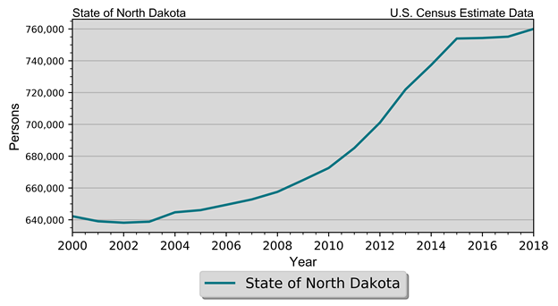
Demographics
Table II.1.1 Population Estimates State of North Dakota 2010-2018 Census Data and Intercensal Estimates
2010 Census | 672,591
2011 Population Estimate | 685,136
2012 Population Estimate | 701,116
2013 Population Estimate | 721,999
2014 Population Estimate | 737,382
2015 Population Estimate | 754,022
2016 Population Estimate | 754,353
2017 Population Estimate | 755,176
2018 Population Estimate | 760,077

Slide 7
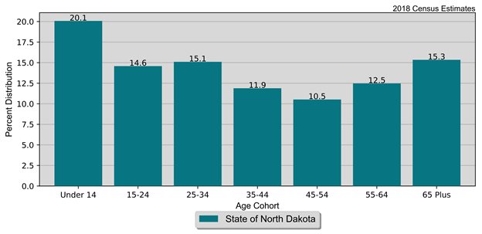
Demographics
Population by Age and Gender
State of North Dakota
2010 Census and Current Census Estimates
Age | 2010 Census | 2018 Estimates | % Change
 |  |  | 18-Oct
Under 14 years | 124,461 | 152,549 | 22.60%
15 to 24 years | 106,430 | 110,861 | 4.20%
25 to 44 years | 90,485 | 114,800 | 26.90%
45 to 54 years | 75,262 | 90,402 | 20.10%
55 to 64 years | 96,657 | 80,005 | -17.20%
65 and Over | 81,819 | 94,823 | 15.90%
Total | 672,591 | 760,077 | 13.00%

Slide 8
Demographics
Population by Race and Ethnicity State of North Dakota 2010 Census & 2018 Five-Year ACS
Race | 2010 Census |  | 2018 Five-Year ACS
 | Population | % of Total | Population | % of Total
White | 605,449 | 90.0% | 655,268 | 87.1%
Black | 7,960 | 1.2% | 20,445 | 2.7%
American Indian | 36,591 | 5.4% | 39,462 | 5.2%
Asian | 6,909 | 1.0% | 10,814 | 1.4%
Native Hawaiian/ Pacific Islander | 320 | 0% | 378 | 0.1%
Other | 3,509 | 0.5% | 7,528 | 1.0%
Two or More Races | 11,853 | 1.8% | 18,306 | 2.4%
Total | 672,591 | 100.0% | 752,201 | 100.0%
Non-Hispanic | 659,124 | 98.0% | 725,672 | 96.5%
Hispanic | 13,467 | 2.0% | 26,529 | 3.5%

Slide 9
Demographics
Disability by Age State of North Dakota 2018 Five-Year ACS Data
Age | Male |  | Female |  | Total
 | Disabled Population | Disability Rate | Disabled Population | Disability Rate | Disabled Population | Disability Rate
Under 5 | 187 | 0.7% | 127 | 0.5% | 314 | 0.6%
5 to 17 | 3,847 | 6.2% | 1,689 | 2.9% | 5,536 | 4.6%
18 to 34 | 4,989 | 4.8% | 5,376 | 5.9% | 10,365 | 5.3%
35 to 64 | 15,931 | 11.8% | 12,484 | 9.7% | 28,415 | 10.8%
65 to 74 | 7,279 | 25.3% | 6,059 | 20.7% | 13,338 | 23.0%
75 or Older | 9,142 | 47.7% | 12,234 | 45.9% | 21,376 | 46.7%
Total | 41,375 | 11.0% | 37,969 | 10.5% | 79,344 | 10.8%

Slide 10
Homelessness
Homeless Count
State of North Dakota
2019 PIT Count
Year | 2015 | 2016 | 2017 | 2018 | 2019
Sheltered | 819 | 707 | 758 | 494 | 545
Unsheltered | 486 | 216 | 331 | 48 | 12
Total | 1,305 | 923 | 1,089 | 542 | 557

Slide 11
Homelessness
Homeless Count
State of North Dakota
2019 PIT Count
Households Type | Sheltered | Unsheltered | Total
Households without children | 371 | 3 | 374
Households with adults and children | 171 | 9 | 180
Households with only children | 3 | 0 | 3
Total | 545 | 12 | 557

Slide 12
Economics
Households by Income State of North Dakota 2010 & 2018 Five-Year ACS Data
Income | 2010 Five-Year ACS |  | 2018 Five-Year ACS
 | Households | % of Total | Households | % of Total
Less than $15,000 | 39,425 | 14.3% | 31,291 | 9.9%
$15,000 to $19,999 | 16,011 | 5.8% | 13,158 | 4.2%
$20,000 to $24,999 | 16,678 | 6.0% | 12,633 | 4.0%
$25,000 to $34,999 | 32,772 | 11.8% | 27,910 | 8.9%
$35,000 to $49,999 | 41,563 | 15.0% | 39,929 | 12.7%
$50,000 to $74,999 | 55,089 | 19.9% | 57,047 | 18.1%
$75,000 to $99,999 | 34,795 | 12.6% | 45,061 | 14.3%
$100,000 or More | 40,309 | 14.6% | 87,874 | 27.9%
Total | 276,642 | 100.0% | 314,903 | 100.0%

Slide 13
Economics
Poverty by Age State of North Dakota 2000 Census SF3 & 2018 Five-Year ACS Data
Age | 2000 Census |  | 2018 Five-Year ACS
 | Persons in Poverty | % of Total | Persons in Poverty | % of Total
Under 6 | 8,173 | 11.1% | 8,604 | 10.9%
6 to 17 | 13,990 | 19.0% | 12,258 | 15.5%
18 to 64 | 41,568 | 56.6% | 48,920 | 61.7%
65 or Older | 9,726 | 13.2% | 9,488 | 12.0%
Total | 73,457 | 100.0% | 79,270 | 100.0%
Poverty Rate | 11.9% | . | 10.9% | .

Slide 14
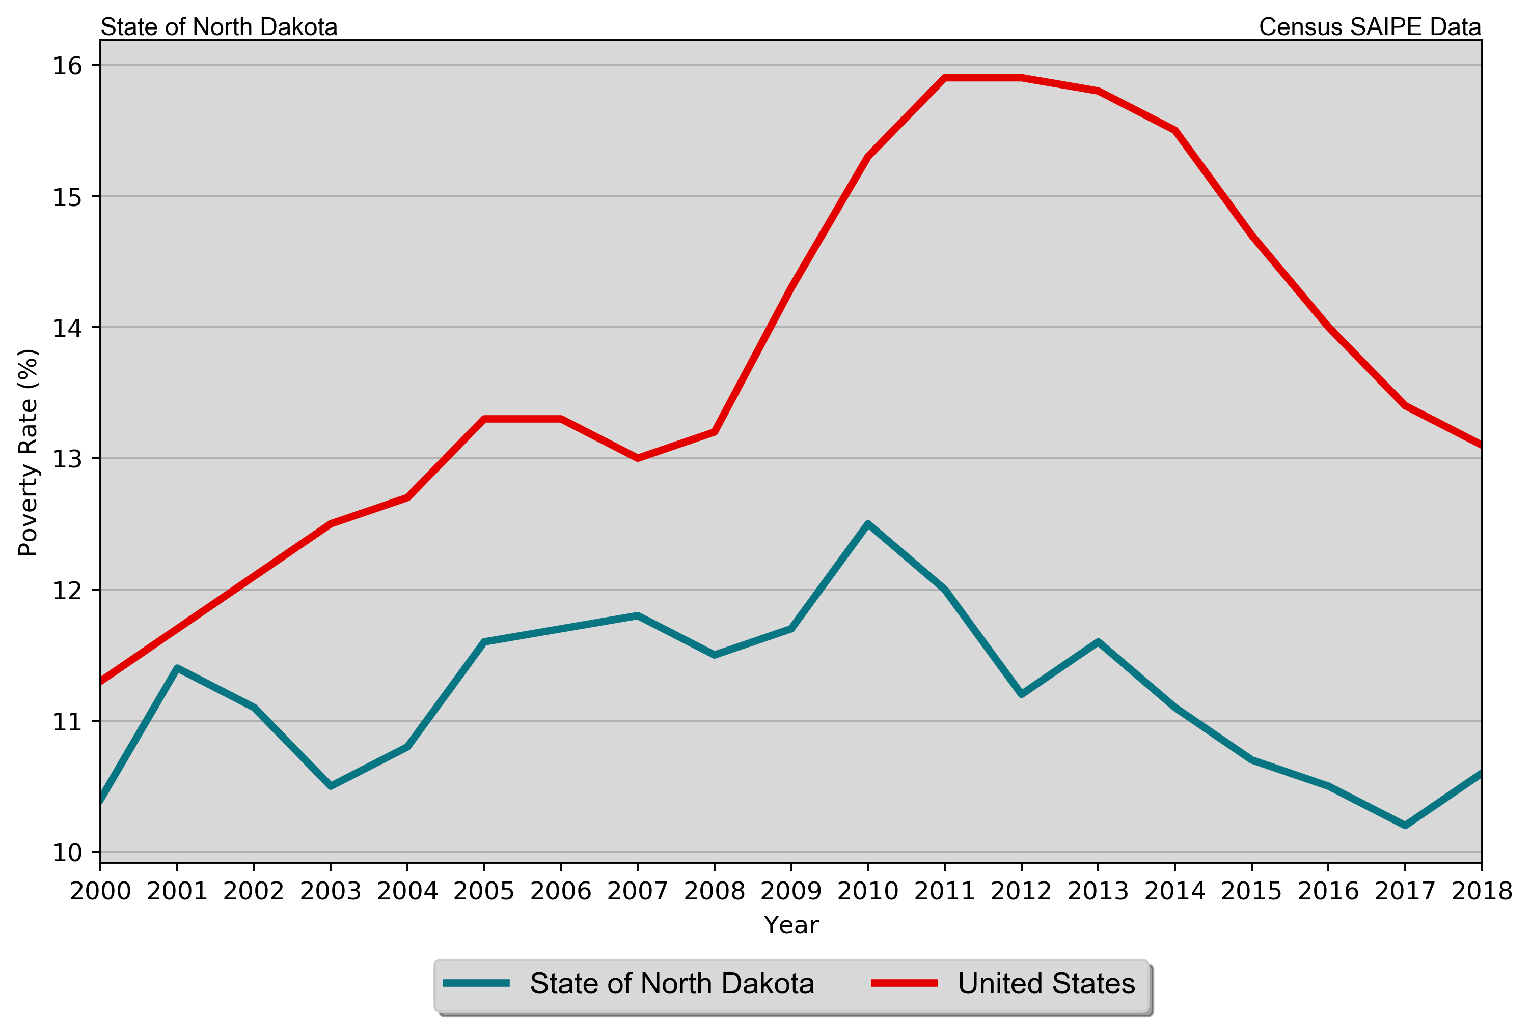
Economics
Poverty Rates
State of North Dakota
SAIPE Estimates 2000 – 2017

Slide 15
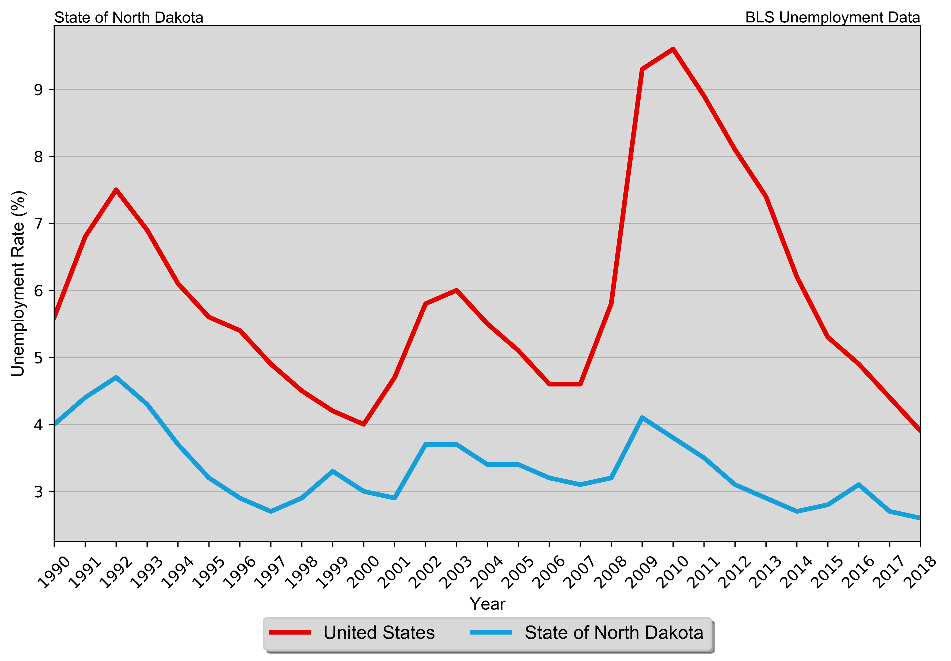
Economics
Annual Unemployment Rate
State of North Dakota
1990 – 2018 BLS Data

Slide 16
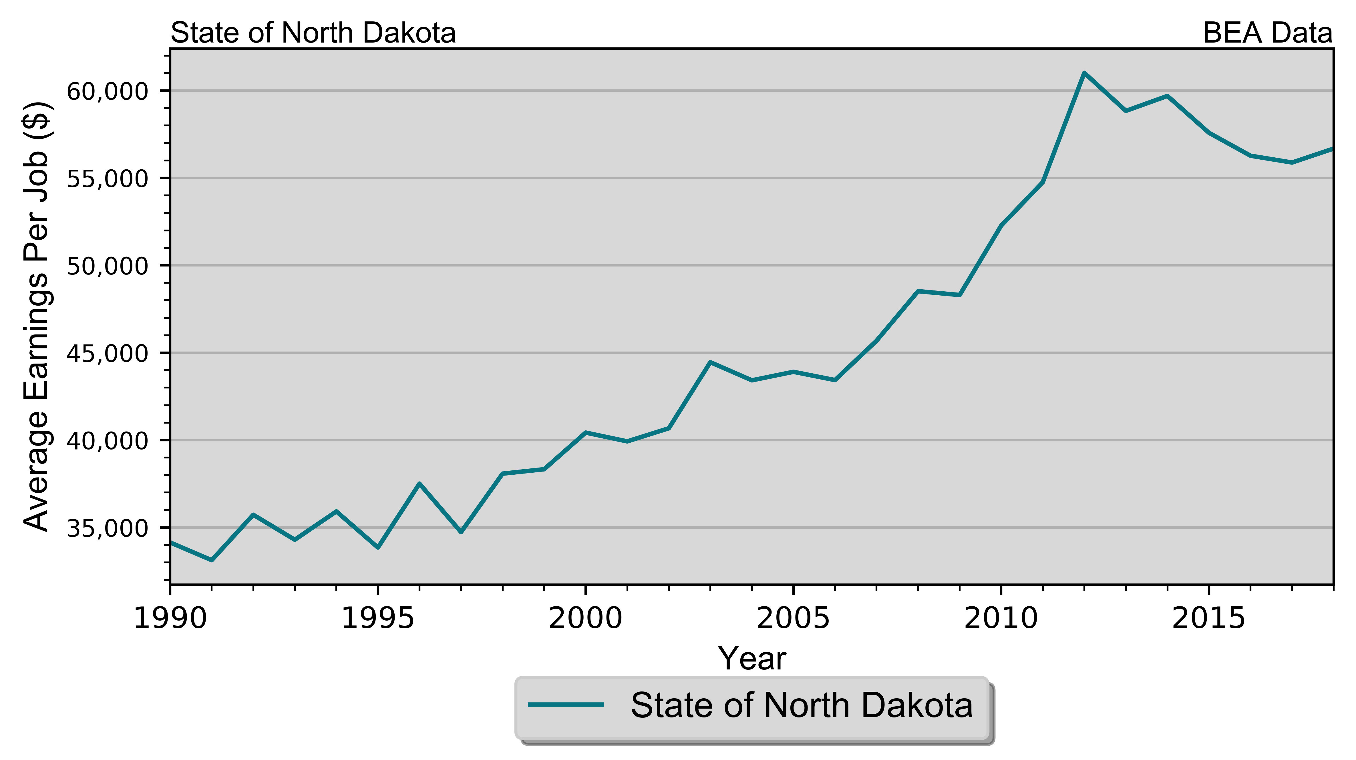
Economics
Real Average Earnings per Job
State of North Dakota

Slide 17
Housing
Housing Units by Type State of North Dakota 2010 & 2018 Five-Year ACS Data
Unit Type | 2010 Five-Year ACS |  | 2018 Five-Year ACS
 | Units | % of Total | Units | % of Total
Single-Family | 208,028 | 66.5% | 231,666 | 63.0%
Duplex | 7,192 | 2.3% | 7,608 | 2.1%
Tri- or Four-Plex | 12,538 | 4.0% | 14,120 | 3.8%
Apartment | 61,360 | 19.6% | 87,402 | 23.8%
Mobile Home | 23,719 | 7.6% | 26,767 | 7.3%
Boat, RV, Van, Etc. | 24 | 0% | 121 | 0%
Total | 312,861 | 100.0% | 367,684 | 100.0%

Slide 18
Housing
Housing Units by Tenure State of North Dakota 2010 Census & 2018 Five-Year ACS Data
Tenure | 2010 Census |  | 2018 Five-Year ACS
 | Units | % of Total | Units | % of Total
Occupied Housing Units | 281,192 | 88.6% | 314,903 | 85.6%
Owner-Occupied | 183,943 | 65.4% | 197,347 | 62.7%
Renter-Occupied | 97,249 | 34.6% | 117,556 | 37.3%
Vacant Housing Units | 36,306 | 11.4% | 52,781 | 14.4%
Total Housing Units | 317,498 | 100.0% | 367,684 | 100.0%

Slide 19
Housing
Households by Year Home Built State of North Dakota 2010 & 2018 Five-Year ACS Data
Year Built | 2010 Five-Year ACS |  | 2018 Five-Year ACS
 | Households | % of Total | Households | % of Total
1939 or Earlier | 44,468 | 16.1% | 38,564 | 12.2%
1940 to 1949 | 13,577 | 4.9% | 13,239 | 4.2%
1950 to 1959 | 29,365 | 10.6% | 28,124 | 8.9%
1960 to 1969 | 30,162 | 10.9% | 28,934 | 9.2%
1970 to 1979 | 61,690 | 22.3% | 57,926 | 18.4%
1980 to 1989 | 36,021 | 13.0% | 36,404 | 11.6%
1990 to 1999 | 32,465 | 11.7% | 35,167 | 11.2%
2000 to 2009 | 28,894 | 10.4% | 38,431 | 12.2%
2010 or Later | . | . | 38,114 | 12.1%
Total | 276,642 | 100.0% | 314,903 | 100.0%

Slide 20
Housing
Disposition of Vacant Housing Units State of North Dakota 2010 Census & 2018 Five-Year ACS Data
Disposition | 2010 Census |  | 2018 Five-Year ACS
 | Units | % of Total | Units | % of Total
For Rent | 7,422 | 20.4% | 12,502 | 23.7%
For Sale | 2,734 | 7.5% | 3,054 | 5.8%
Rented Not Occupied | 554 | 1.5% | 2,694 | 5.1%
Sold Not Occupied | 1,043 | 2.9% | 1,297 | 2.5%
For Seasonal, Recreational, or Occasional Use | 11,483 | 31.6% | 15,898 | 30.1%
For Migrant Workers | 319 | 0.9% | 858 | 1.6%
Other Vacant | 12,751 | 35.1% | 16,478 | 31.2%
Total | 36,306 | 100.0% | 52,781 | 100.0%

Slide 21
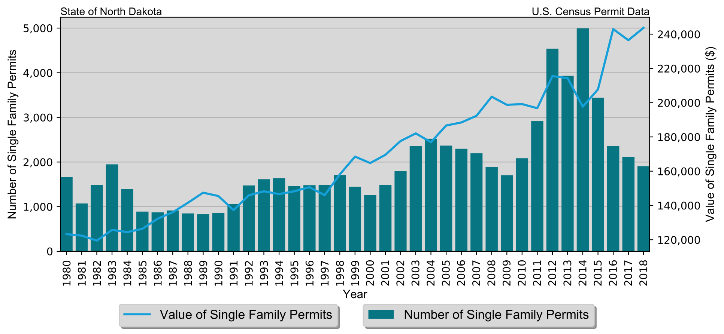
Housing
Single-Family Permits
State of North Dakota
Census Bureau Data, 1980–2018

Slide 22
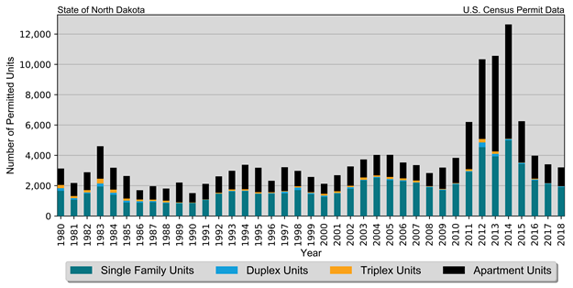
Housing
Total Permits by Unit Type
State of North Dakota
Census Bureau Data, 1980–2018

Slide 23
Housing
Median Rent State of North Dakota 2018 Five-Year ACS Data
Place | Rent
Median Rent | $722
Median Home Value | $185,000

Slide 24
Housing Problems
Cost Burden and Severe Cost Burden by Tenure
State of North Dakota
2010 & 2018 Five-Year ACS Data
Data Source | 31%-50% |  | Above 50% |  | Total
 | Households | % of Total | Households | % of Total
Owner With a Mortgage
2010 Five-Year ACS | 15,888 | 15.80% | 5,981 | 5.90% | 100,620
2018 Five-Year ACS | 12,073 | 11.50% | 5,573 | 5.30% | 104,979
Owner Without a Mortgage
2010 Five-Year ACS | 5,927 | 7.10% | 4,307 | 5.20% | 83,497
2018 Five-Year ACS | 4,466 | 4.80% | 3,968 | 4.30% | 92,368
Renter
2010 Five-Year ACS | 16,711 | 18.10% | 17,299 | 18.70% | 92,525
2018 Five-Year ACS | 21,605 | 18.40% | 20,358 | 17.30% | 117,556
Total
2010 Five-Year ACS | 38,526 | 13.90% | 27,587 | 10.00% | 276,642
2018 Five-Year ACS | 38,144 | 12.10% | 29,899 | 9.50% | 314,903

Slide 25
What we are doing:
Housing and Community Development Survey
Three Focus Groups: Affordable Housing, Homelessness, Public Services
Regional Public Input Meetings
Public Review Meeting

Slide 26
Public Service Needs:
What groups of people at most in need?
What types services do households need in North Dakota?

Slide 27
Community Needs
What challenges do service providers face in meeting needs?
What can the State do to help meet the needs of households and service providers?

Slide 28
Community Input
What is the State doing well to address community needs?
What programs or efforts can be improved?
Other comments?

Slide 29
What is coming up:
February 24 – Focus Groups
Regional Community Meetings
Public Review Meeting

Slide 30
Consolidated Plan
Contact:
Bonnie Malo
Director
Division of Community Services
701.328.2476
bmalo@nd.gov

